Slide 1
Training, Carrers and Diversity
Maria J G Borge
Instituto de Estructura de la Materia
CSIC

Slide 2
Training; In order to enhance the competitiveness of our research infrastructures and its technical capabilities, we should publicise training schools and events. We propose annual training schools in experimental nuclear facilities of different sizes.
Carrers: Opportunities for the Ph’s in Academia, Industry and High school
Diversity: A big effort should be realized to ensure large diversity, engaging people of different nationality, gender, age, and level of professional expertise.

Slide 3
Nuclear Science – People and Society
Training, Careers & Diversity
Coordinator: Maria Jose Garcia Borge
Members
Livius Trache: livius.trache@nipne.ro
Thomas Nilsson: Thomas.Nilsson@chalmers.se
Johan Collot (Grenoble): Johann.Collot@lpsc.in2p3.fr,
Michele Coeck, SCK : mcoeck@sckcen.be
Magnus Schlösser (KIT) : magnus.schloesser@kit.edu,
Axel Boeltzig (HZDR) : a.boeltzig@hzdr.de
Alessandra Fantoni: alessandra.fantoni@lnf.infn.it ,
Hans Fynbo: fynbo@phys.au.dk
Fanny Farget: fanny.farget@ganil.fr
Agnieszka Korgul: Agnieszka.Korgul@fuw.edu.pl

Slide 4
Valuing Diversity & Capitalising on it
Create a work environment that accelerates productivity and innovation and promotes life- work balance;
Have a positive impact in attracting, retaining, and promoting diverse sets of skills;
Added Value for society. Have a positive impact in attracting, retaining, and promoting diverse sets of skills;
Fight prejudice and discrimination, fostering a culture of inclusion based on respect for indi- vidual human beings.
Valuing the characteristics, skills and talents of each person promotes equal treatment and opportunities
Contribute to personal and professional development towards the improvement of social and economic standards.
Developing an organizational culture based on mutual respect, recognition and appreciation of individual differences and talents;
Monitoring, analyzing, evaluating and sharing information on gender, tenure and age diversity, citizenship and workplace (country);
Promoting understanding, learning about other practices, sharing of experiences among the various signatory organizations, and wider public initiatives.

Slide 5
Achieving diversity in Research
Research has a diversity problem. Many groups are underrepresented in research including women, ethnic minorities, people with disabilities and socially disadvantaged populations. Attention to the issue is growing, and some institutions and scientific communities are actively seeking to increase diversity. But far more needs to be done.
This collection of articles, a collaboration between Nature Research and Scientific American,
https://www.nature.com/collections/qsgnpdtgbr
focuses on the barriers faced by women and how they might be overcome, but also includes articles about the challenges encountered by other underrepresented groups in science. The collection highlights our long-standing commitment to covering gender-related issues and other aspects of diversity. We hope that this collection will stimulate discussion and build support for greater diversity in research and beyond.

Slide 6
USEFUL LINKS
Diversity and Inclusion IOP:
https://theiop.org/iop-diversity-inclusion-panel/
https://theiop.org/inclusion-and-diversity/
https://www.iop.org/about/blogs/impact-APPG-diversity-inclusion-recommendations
Rodi collect below a few starting pages for Diversity and Education by the EPS, UKRI, IoP, JENAS and APS.
These are all just starting points and resources to build upon.
EPS: (Look under Education and under Policy)
https://www.eps.org/
UKRI (Lots of data and policies):
https://www.ukri.org/what-we-offer/supporting-healthy-research-and-innovation-culture/equality-diversity-and-inclusion/
IoP:
https://www.iop.org/about/IOP-diversity-inclusion
https://www.iop.org/education
JENAS:
https://nupecc.org/jenaa/?display=diversity
APS:
https://www.aps.org/about/governance/committees/commin/index.cfm
https://aps.org/programs/education/policy.cfm

Slide 7
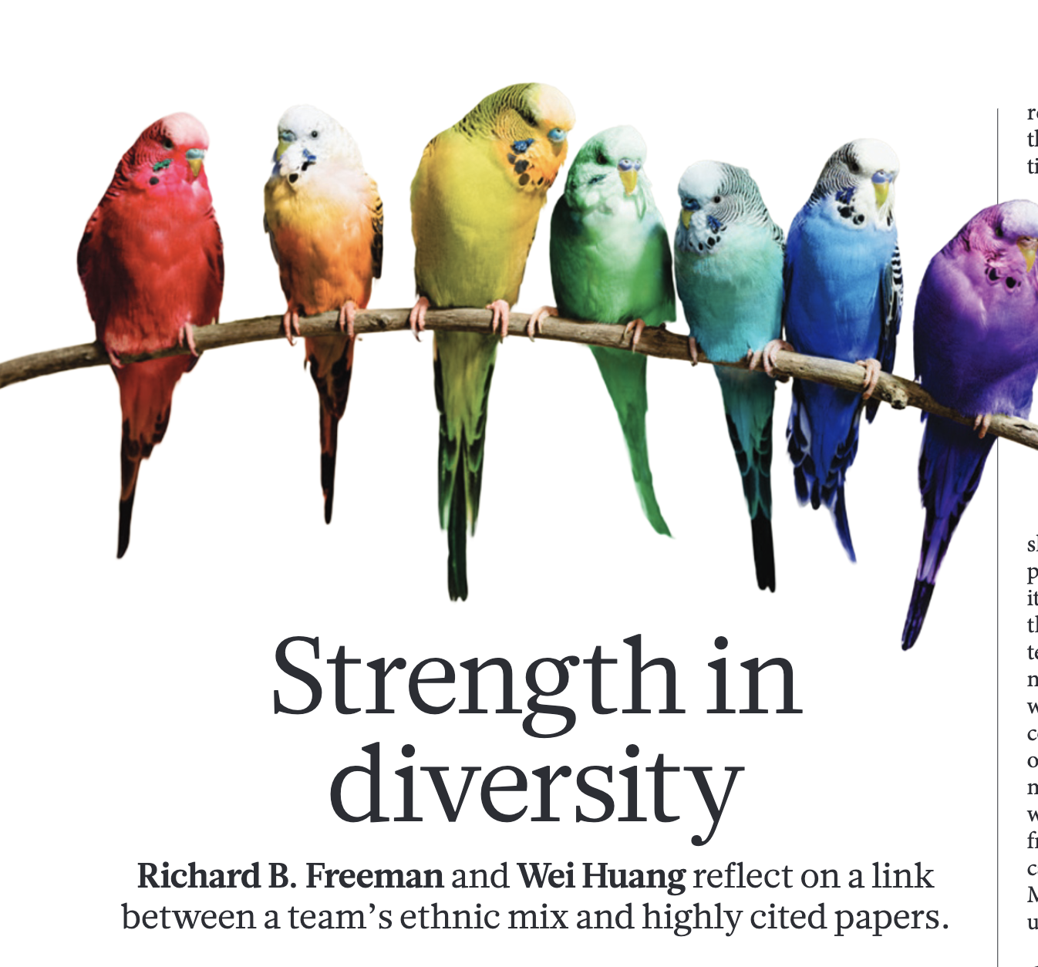
Nature 513 (2014) 305
This emphasised ethic mixing

