Slide 1

NuPECC LRP2024-WTG-Detectors and Exp. Techniques, kick-off meeting
Frascati, April 17th – 18th 2023
Perspectives for detectors for low-energy nuclear physics
Andrea Gottardo et al.
INFN Laboratori Nazionali di Legnaro

Slide 2
Perspectives for detectors for low-energy nuclear physics
2
NuPECC LRP2024-WTG-Detectors and Exp. Techniques
DISCLAIMER:
talk concentrated on topic not already addressed in dedicated talks.
CAVEAT:
examples, no pretence to be exhaustive on a potentially vast matter !
OUTLINE
HPGe 𝛾–ray detectors
Scintillators detectors for 𝛾–rays
Scintillators for heavy ions
Segmented Si detector arrays
Si arrays for nuclear astrophysics
Time projection chambers (low gas pressure)
Focal plane detectors for high counting rate
Innovative fast neutron detectors
Inputs from the community

Slide 3
Perspectives for detectors for low-energy nuclear physics
3
NuPECC LRP2024-WTG-Detectors and Exp. Techniques
Perspectives for detectors: general considerations
Versatility: - setups made by (sometimes many !) different detectors combined together
- detectors movable among different facilities
State-of-the-art digital electronics for large granularity/large solid angle coverage
Commercial electronics or in-house development ?
Large-scale arrays (at least in terms of complexity) -> large structured collaborations

Slide 4
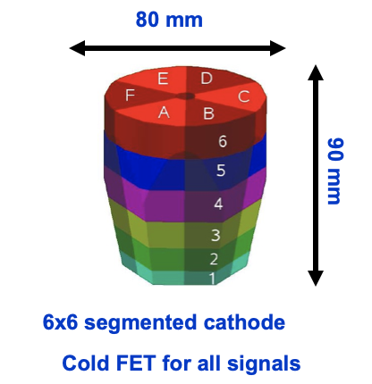
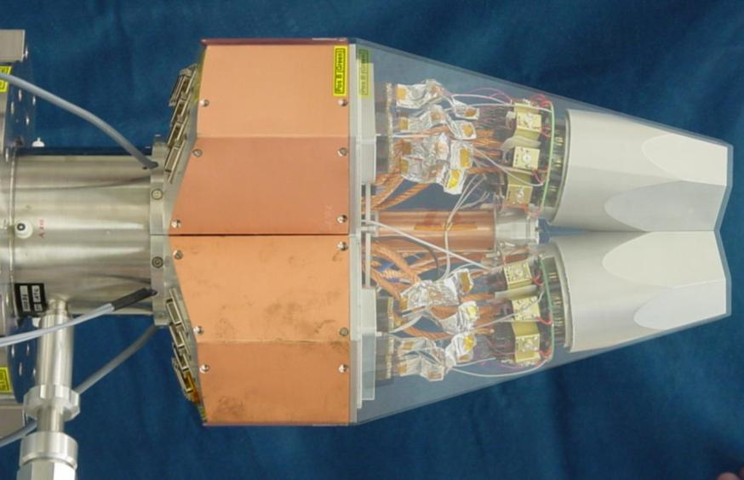
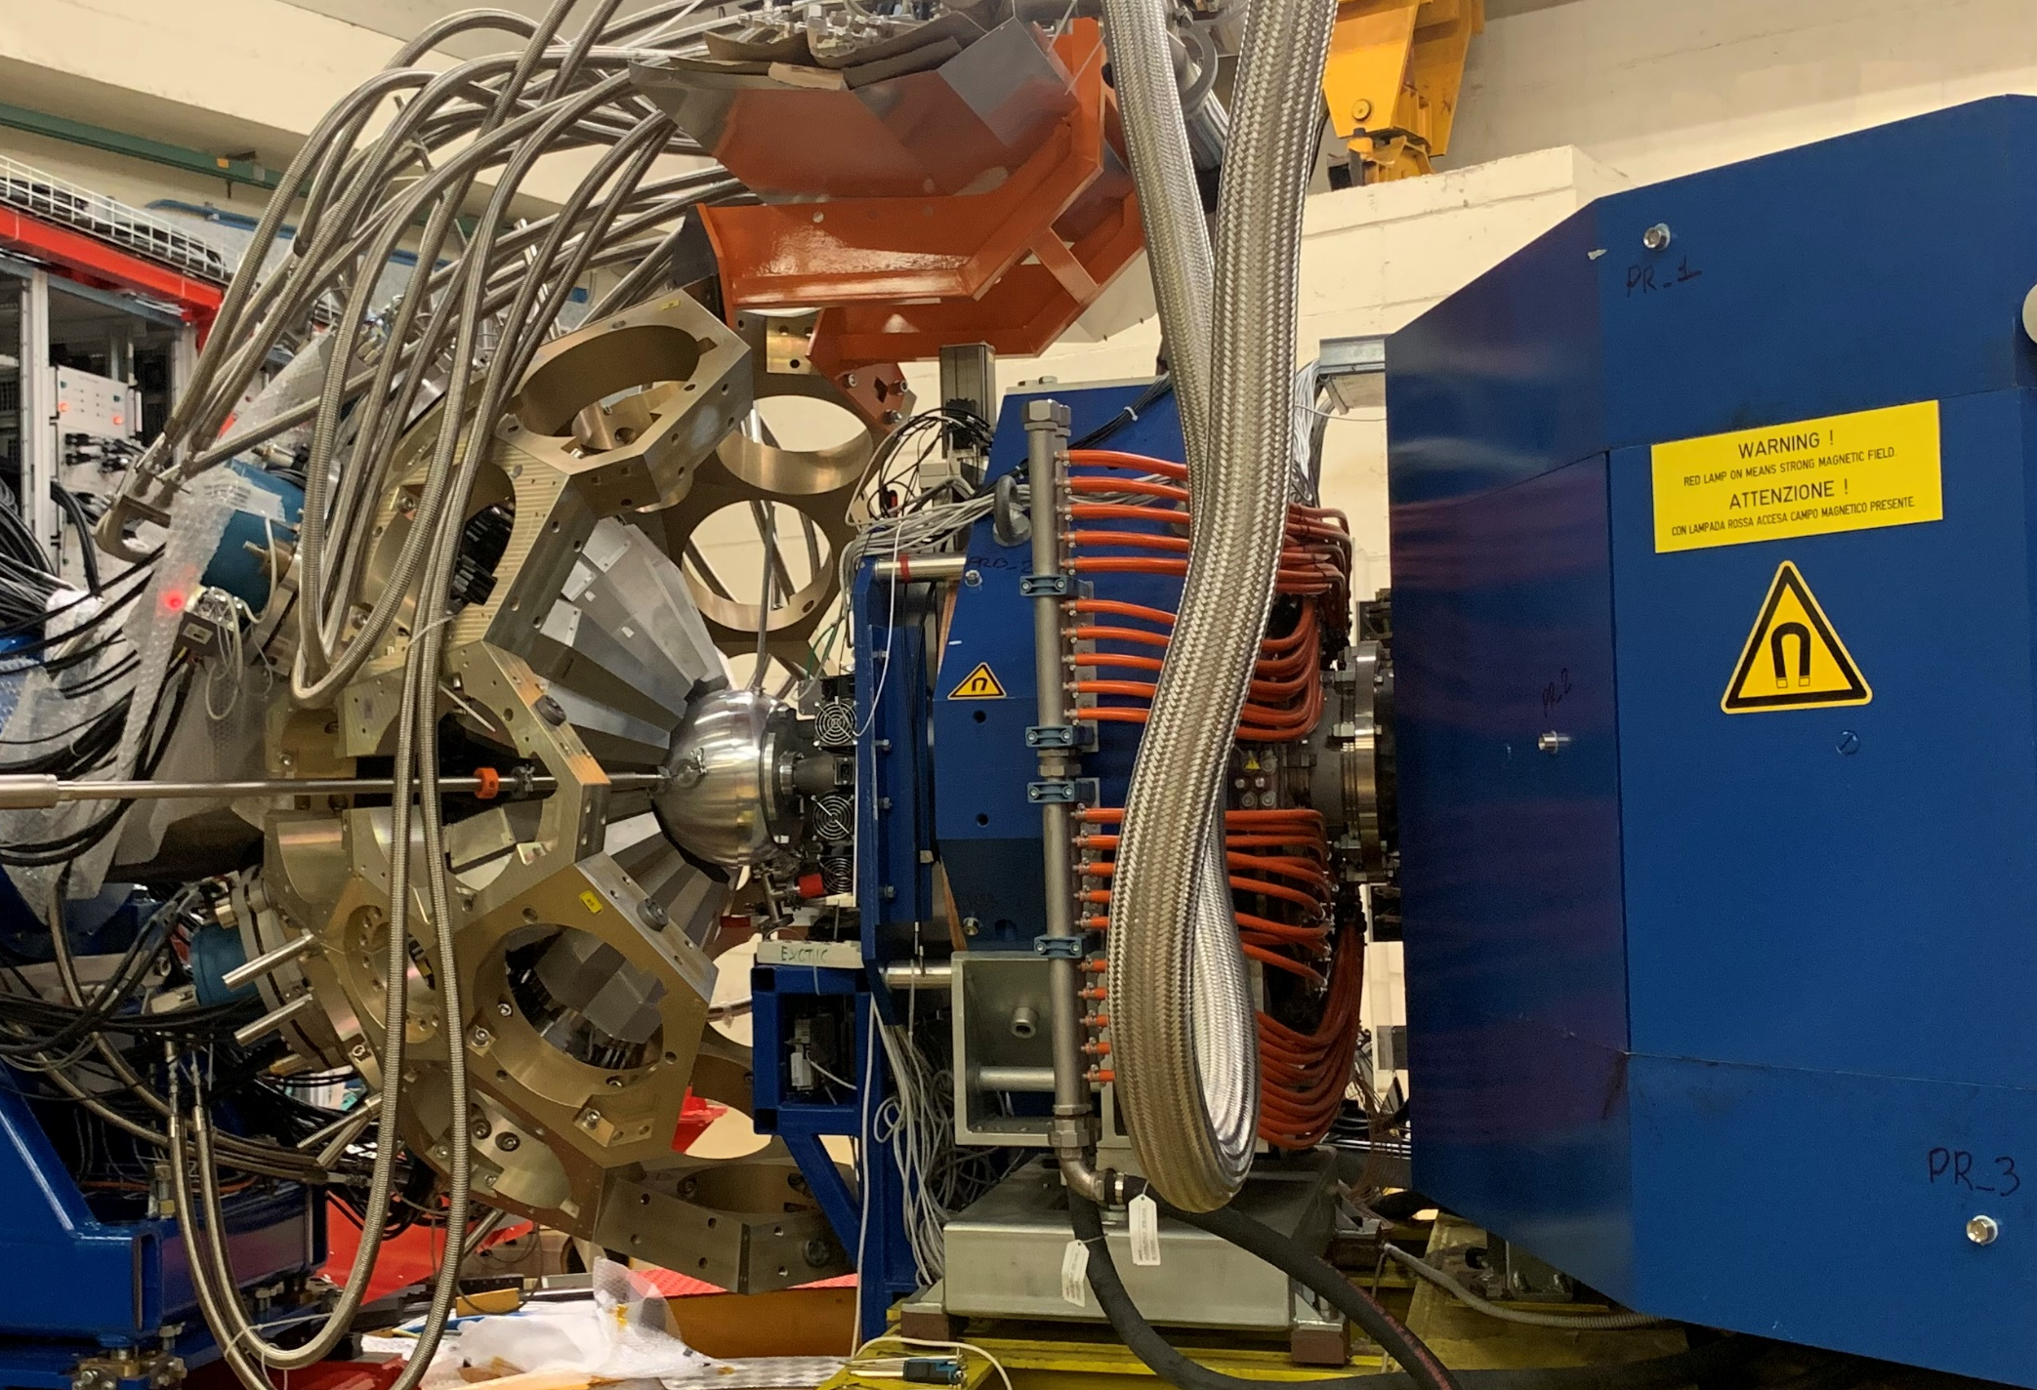
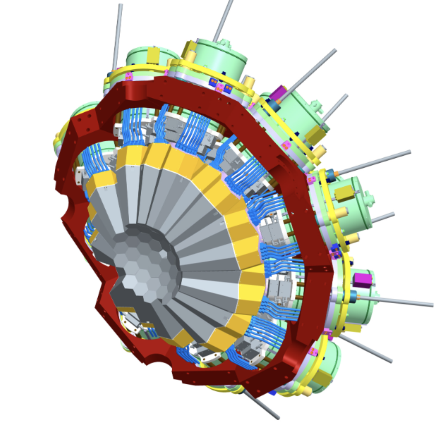
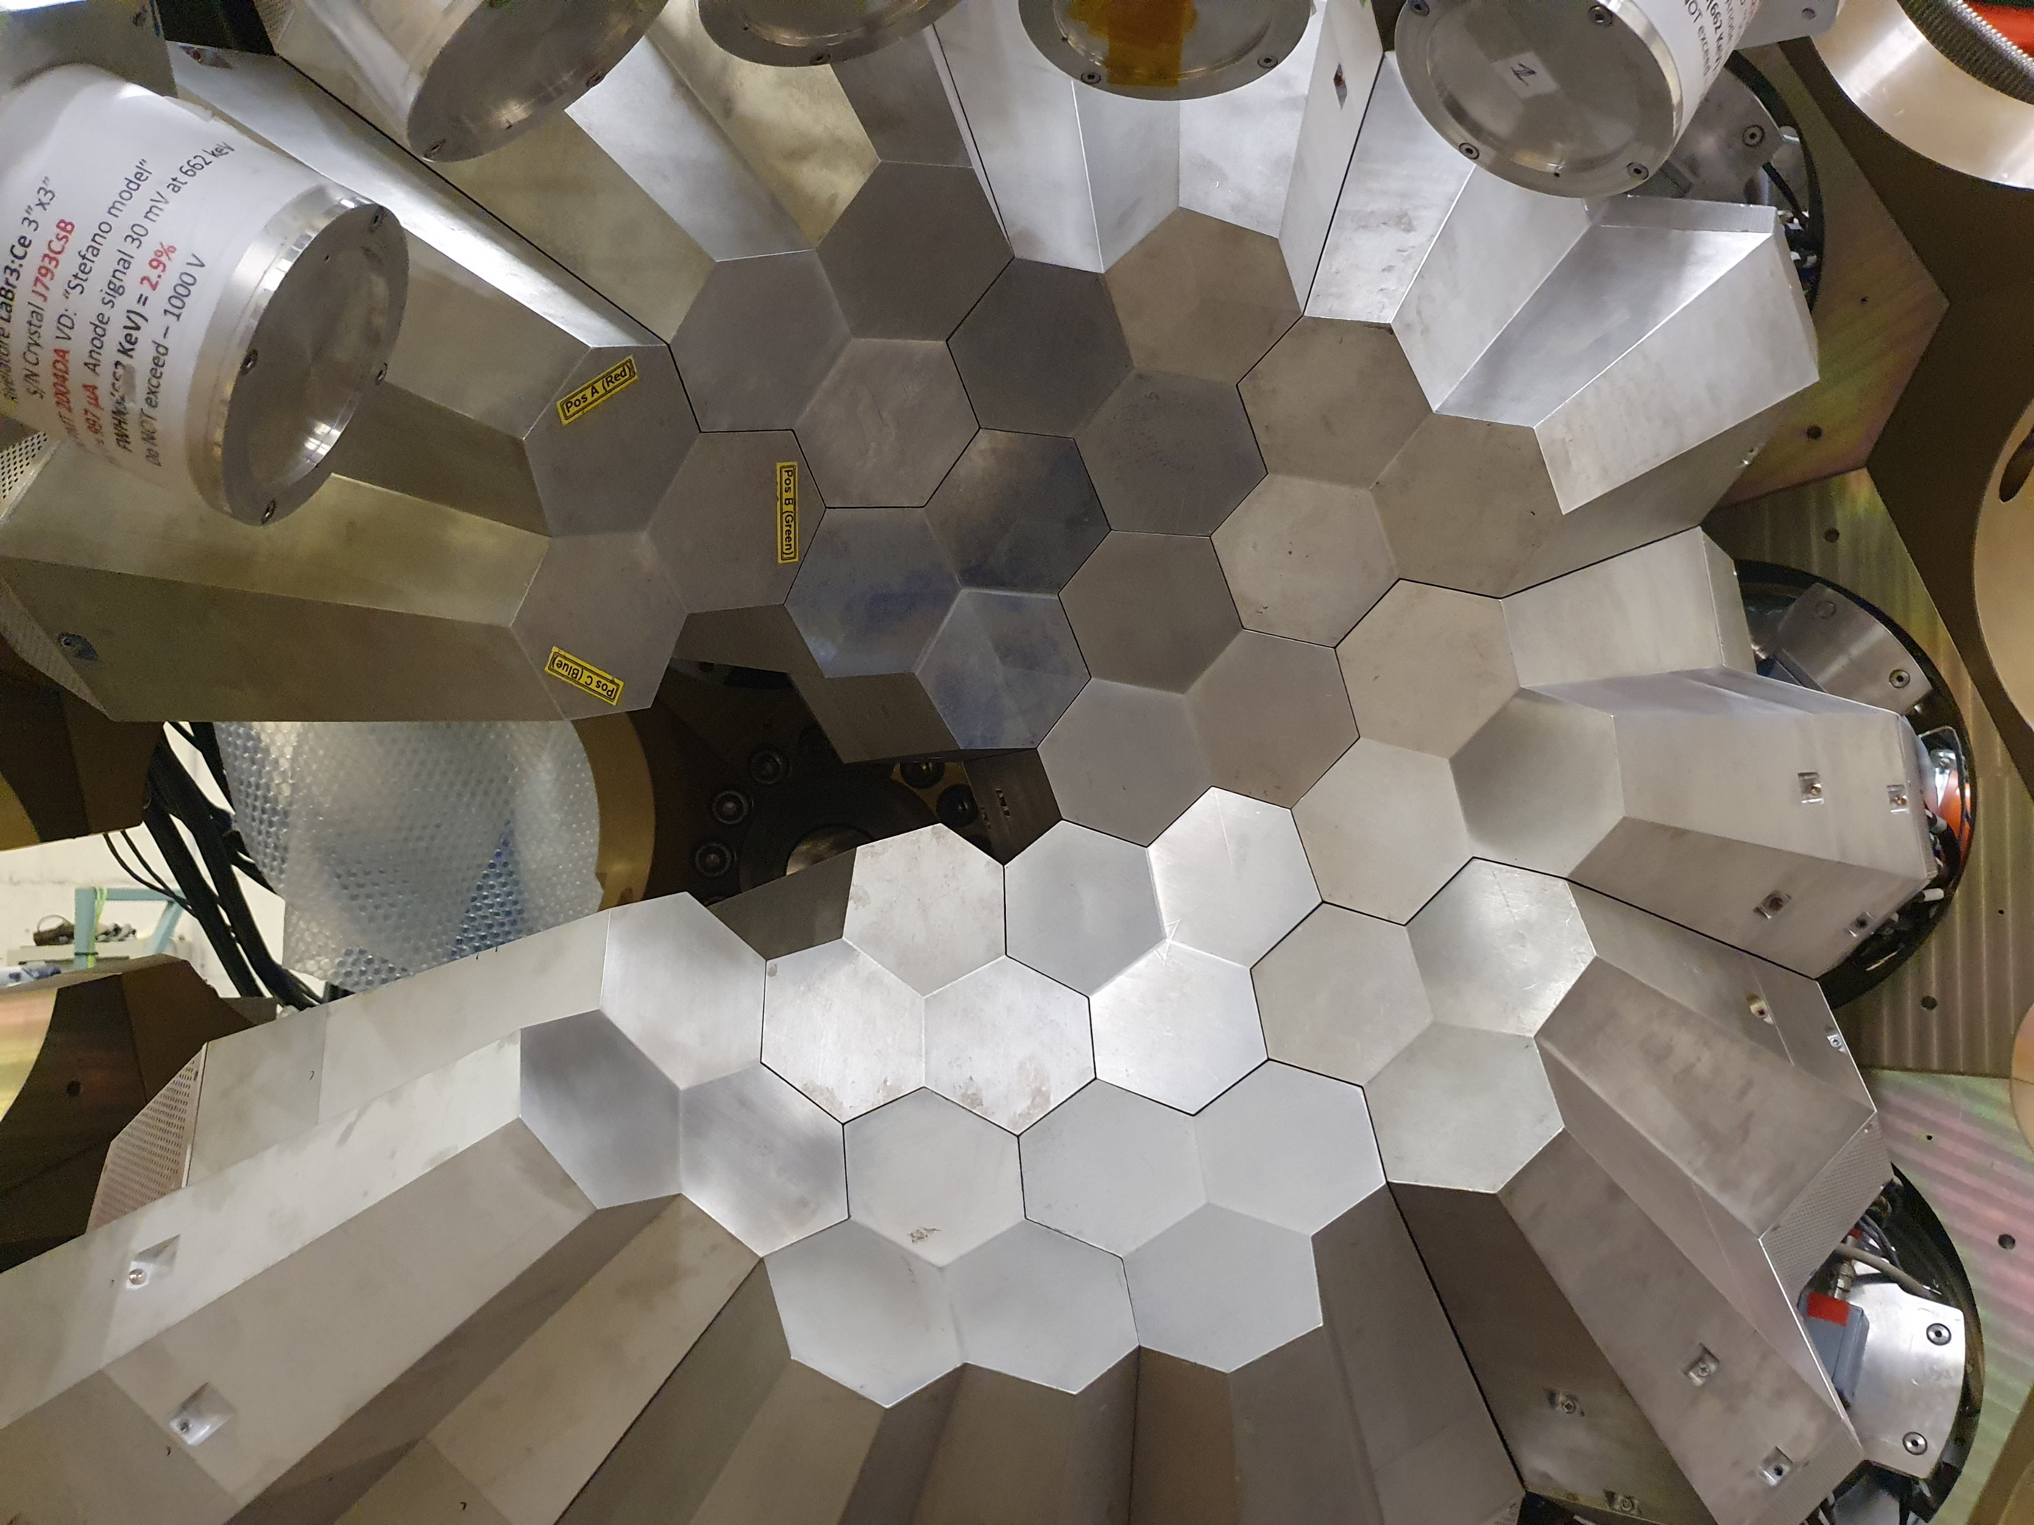
Perspectives for detectors for low-energy nuclear physics
4
NuPECC LRP2024-WTG-Detectors and Exp. Techniques
AGATA: 𝛾-ray tracking array
European-wide collaboration of 41 institutions/institutes
180 hexagonal crystals
60 triple-clusters
Amount of germanium 362 kg
Solid angle coverage 82 %
36-fold segmentation 6480 segments
Singles rate >50 kHz
Efficiency: 43% (M_{γ}=1) 28% (M_{γ}=30)
Peak/Total: 58% (M_{γ}=1) 49% (M_{γ}=30)
AGATA + PRISMA

Slide 5
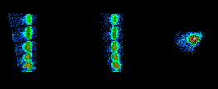
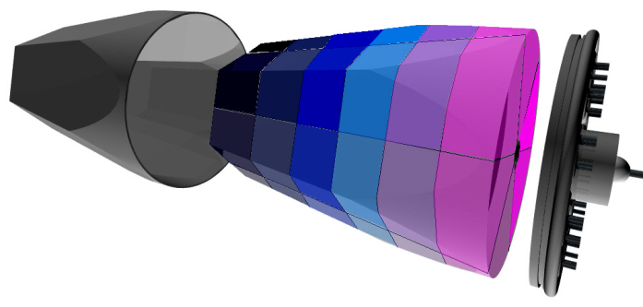
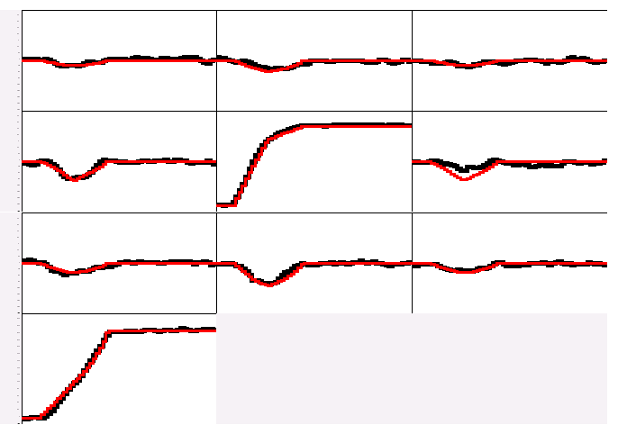
Perspectives for detectors for low-energy nuclear physics
5
NuPECC LRP2024-WTG-Detectors and Exp. Techniques
Electrically segmented HPGe detectors
Identification of the individual interaction points
Reconstruction of tracks
evaluating permutations
of interaction points
·
(x,y,z,E,t)_{i}
·
·
·
·
·
·
·
Deconvolution of the recorded waves through comparison with reference signals
g
A3
A4
A5
Digital electronics
to record and process segment signals
B3
B4
B5
C3
C4
C5
measured calculated
Energy and direction of γ-rays
CORE

Slide 6
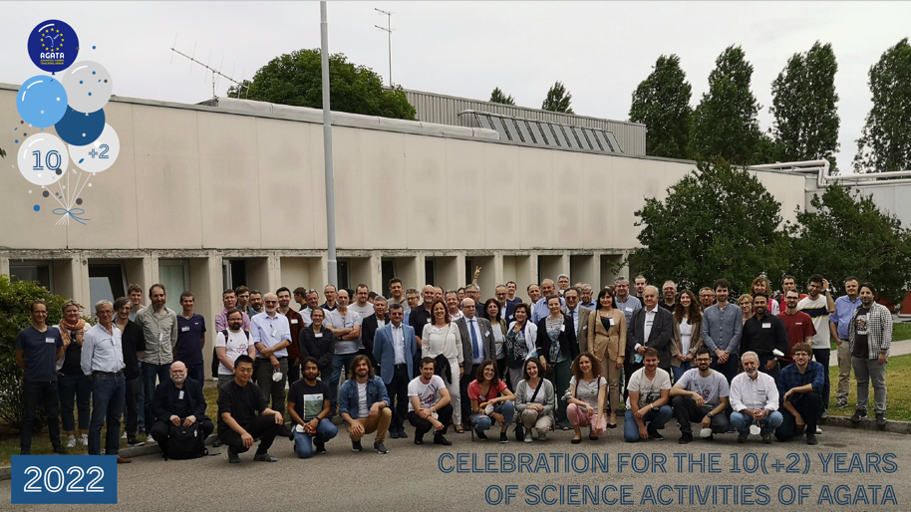
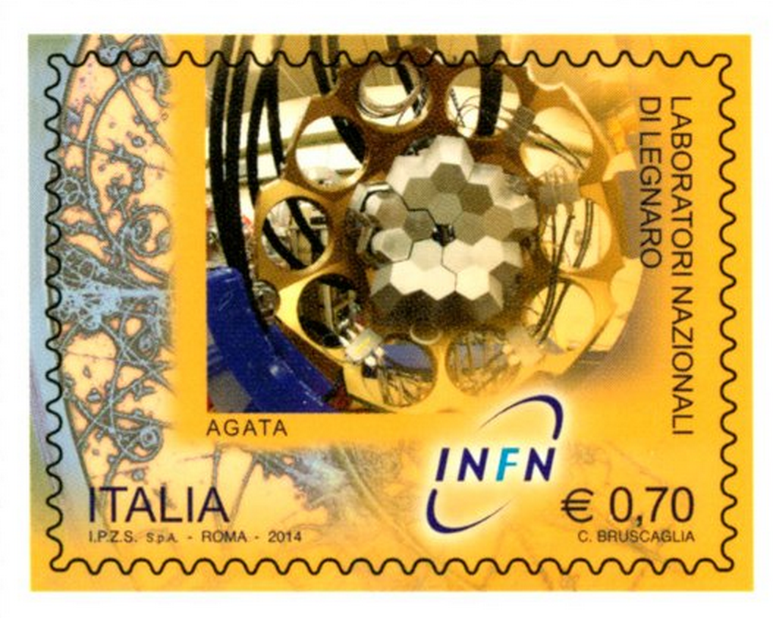
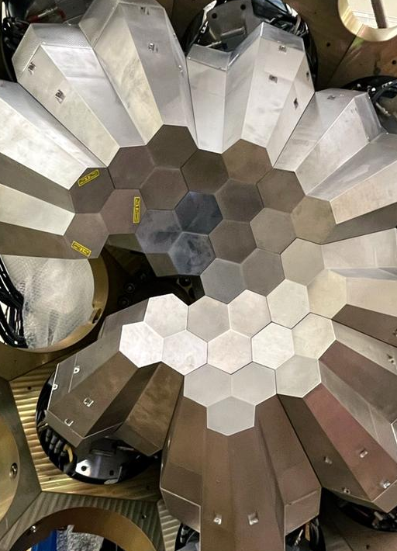
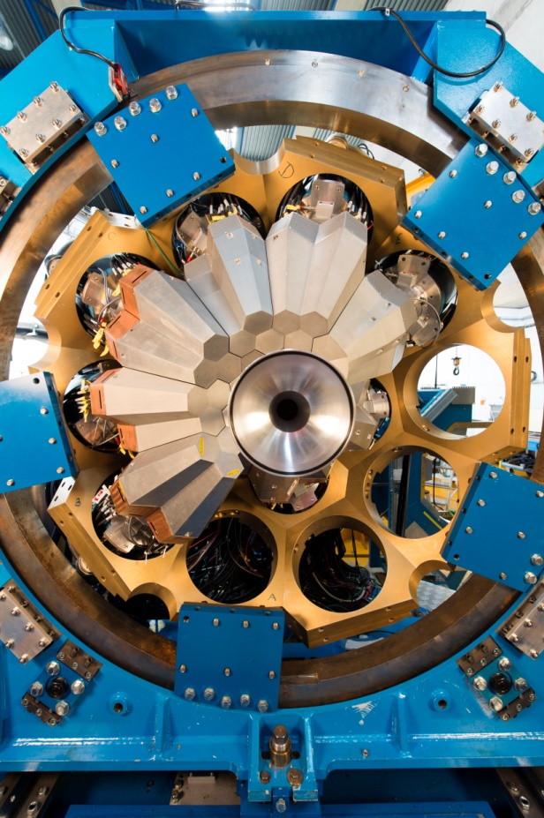
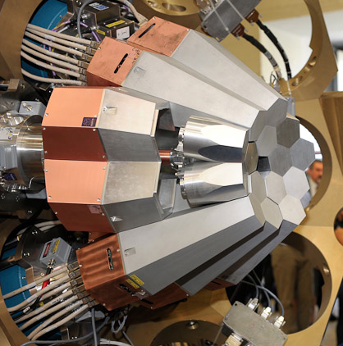
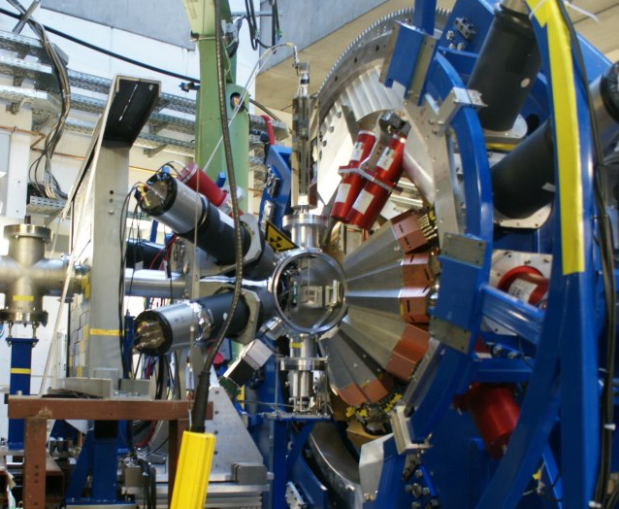
Perspectives for detectors for low-energy nuclear physics
6
NuPECC LRP2024-WTG-Detectors and Exp. Techniques
Celebration 10(+2) years
The AGATA time line
MoU signed for a 3𝜋 array
AGATA@LNL
AGATA@GSI
AGATA@GANIL
AGATA@LNL
?
M. Zielinska physics coordinator
2009
2011
2014
2021-2025
Phase 1
Phase 2

Slide 7
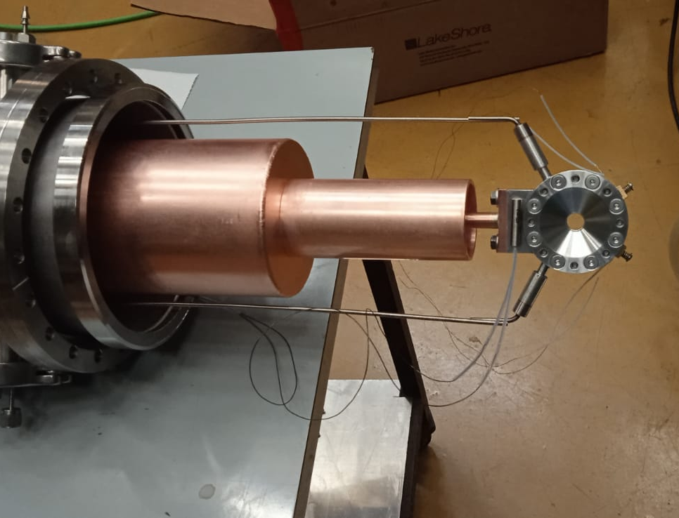
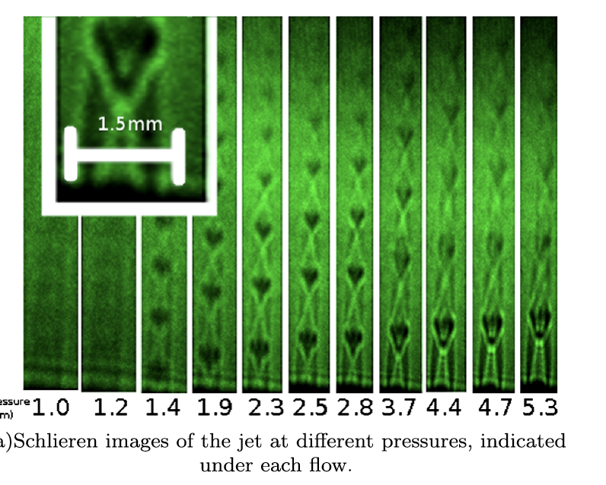
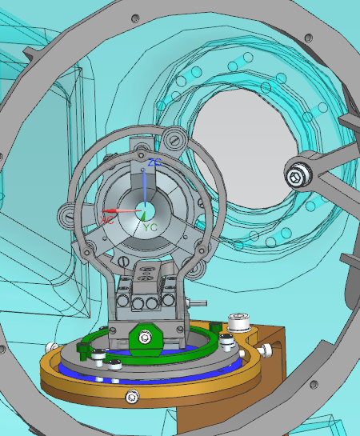
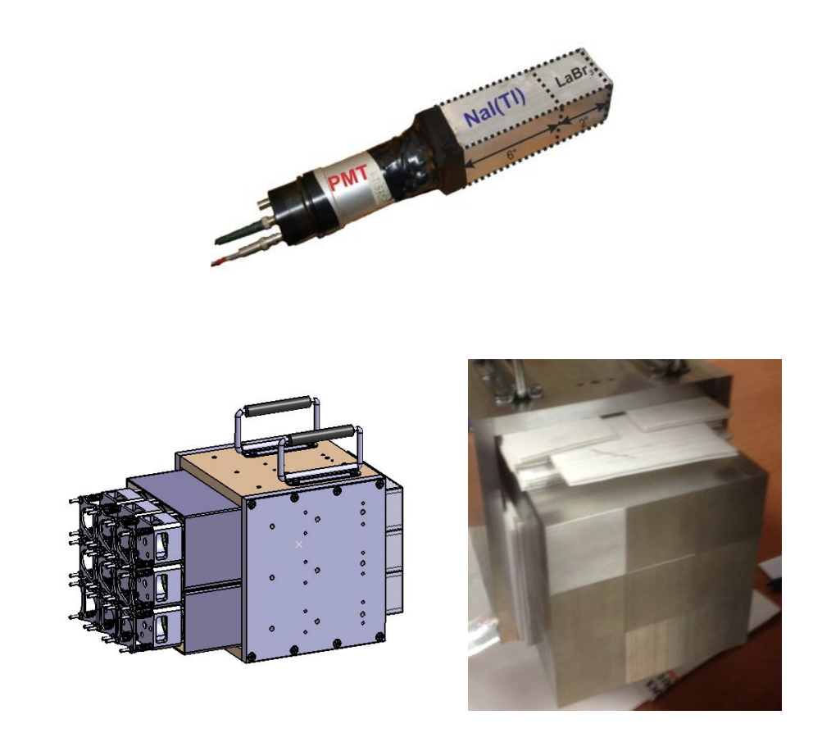
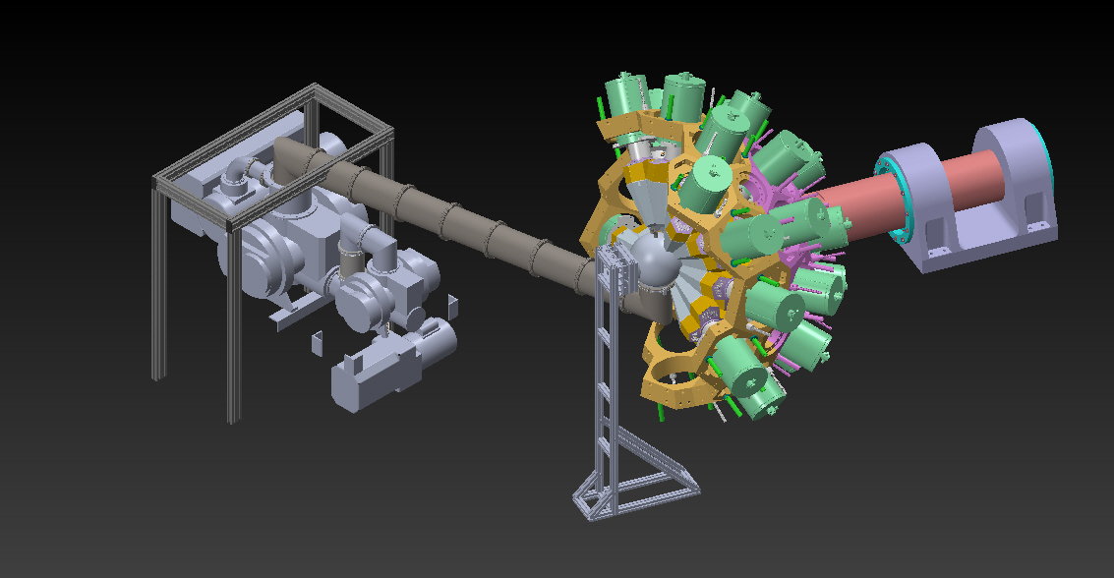
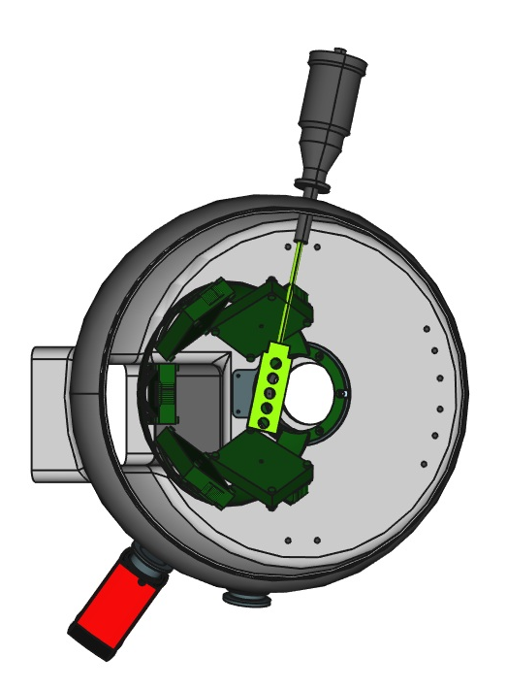
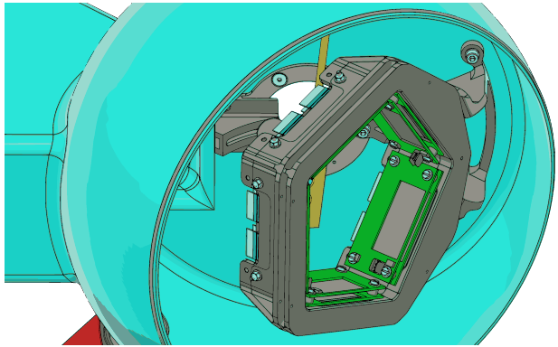
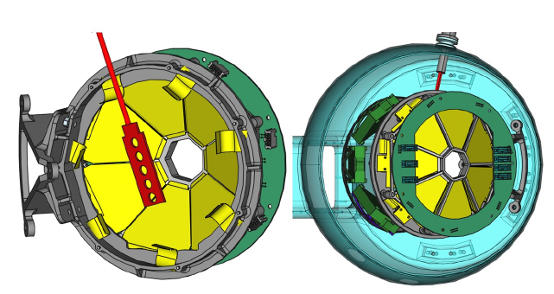
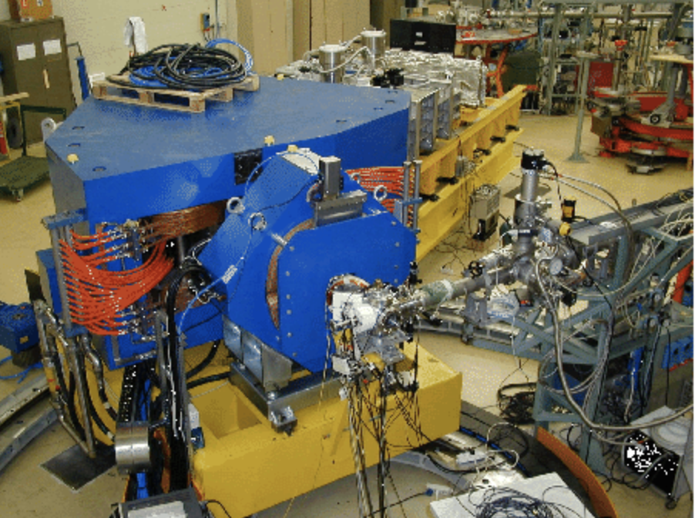
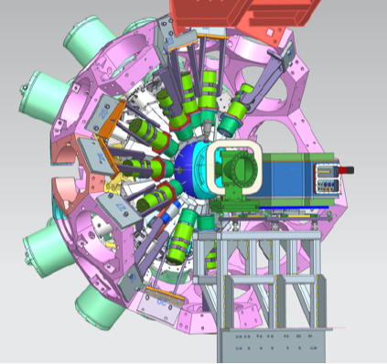
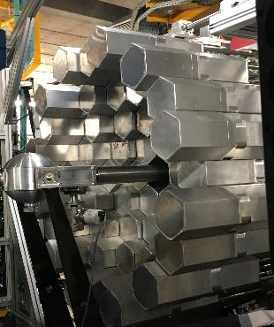
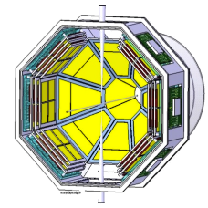
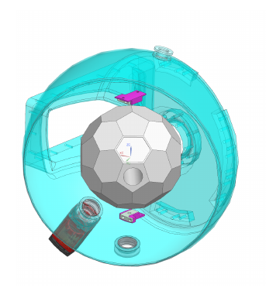
Perspectives for detectors for low-energy nuclear physics
7
Complementary detectors
NuPECC LRP2024-WTG-Detectors and Exp. Techniques
PRISMA/VAMOS
GAL-TRACE
EUCLIDES/DIAMANT
SPIDER/annular CD
DANTE
LaBr3/PARIS
PLUNGER
NEDA/Neutron Wall
Targets: CTADIR + SUGAR
PARIS
GRIT
NEDA

Slide 8
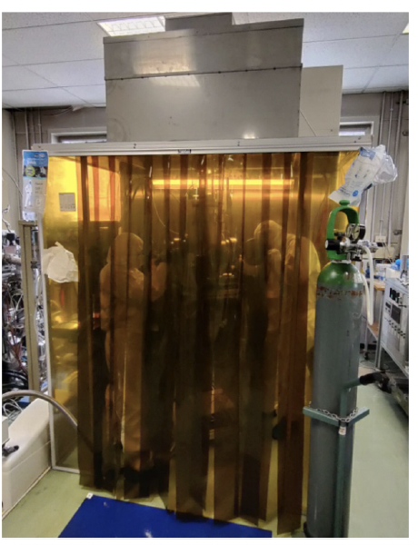
Perspectives for detectors for low-energy nuclear physics
8
NuPECC LRP2024-WTG-Detectors and Exp. Techniques
Developement of new p-type HPGe for 𝛾-ray spectroscopy: N3G
Fabrication of p-HPGe detector using a new doping technique:
pulsed laser melting 200-300 nm junction for n and p side without bulk contamination.
• New generation of electronics, DAQ and cryostat for this technology
• Performance and rad-hardness test
1. n-side segmentation
2. Higher active volume
3. Easy segmentation: 300nm
junctions
4. Lower annealing deterioration
1. Planar detector prototype (PRONG- INFN)
2. Coaxial geometry upgrade
RETURN TO
1. International gamma ray community
2. INFN CSN3: new detector
3. Detector repair infrastructure @ LNL
1) G. Maggioni et al. Eur. Phys. J. A, 54, 34 (2018)
2) V. Boldrini et al. J. Phys. D. Appl. Phys., 52, 11 (2019)
W. Raniero et al. nuovo Cim, 44, 1–5 (2021)
D. De Salvador et al. Patent WO 2021/214028 A1

Slide 9
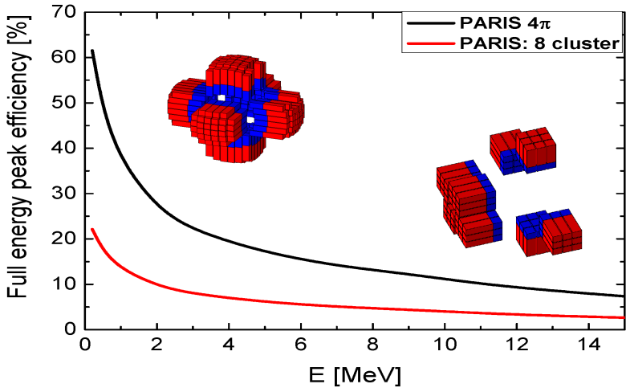
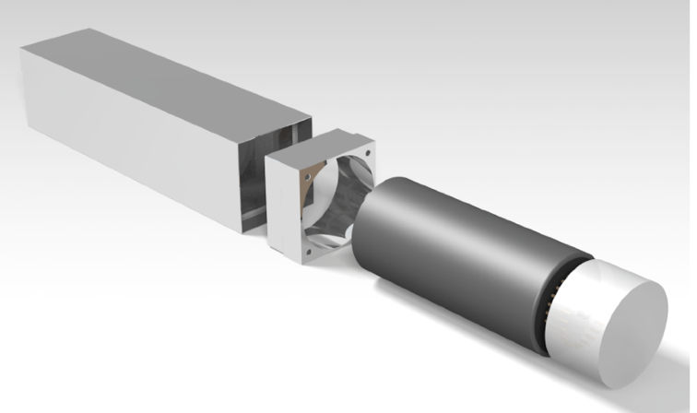
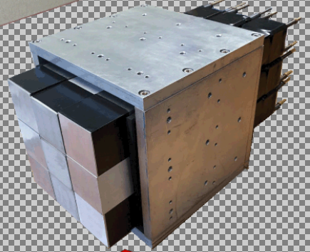
Perspectives for detectors for low-energy nuclear physics
9
NuPECC LRP2024-WTG-Detectors and Exp. Techniques
Scintillator arrays for 𝛾-ray spectroscopy
PARIS
major array/calorimeter for high-energy photons (5-25 MeV) and medium-energy resolution
A workhorse for present and future experiments with STABLE and RADIOACTIVE beams (at LNL, GANIL, GSI, Orsay, ...)
It can be used STAND-ALONE or COUPLED with:
- germanium arrays (e.g., AGATA, EXOGAM)
- particle detectors (e.g., GRIT, NEDA, FAZIA, ACTAR)
- heavy-ion spectrometers (e.g., VAMOS, PRISMA, LISE, S³, SuperFRS).
in 2024: possible campaign with AGATAL@LNL
The collaboration and the array development are described and formalized in a PARIS MoU and its amendments.
Mechanical piece
PARIS is composed of “phoswich” detectors: a frontal part 2”×2”×2” composed by LaBr₃:Ce/CeBr₃ scintillators coupled to a 2”×2”×6” NaI scintillator
INTERNATIONAL PARTNERS: IN2P3 and GANIL (France), COPIN Consortium (Poland), INFN (Italy), TIFR/BARC/VECC (India), IFIN HH (Romania), University of Surrey, University of York (U.K.), Nigde University, Sebahattin Zaim University, Istanbul Technical University, Akdeniz University (Turkey), and GSI/FAIR (Germany).

Slide 10
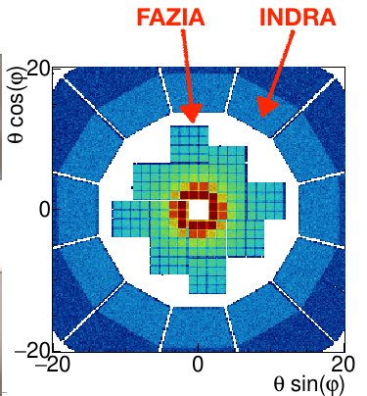
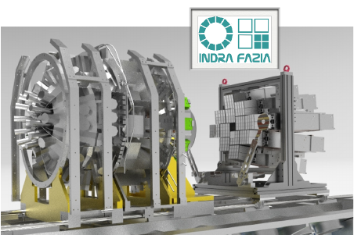
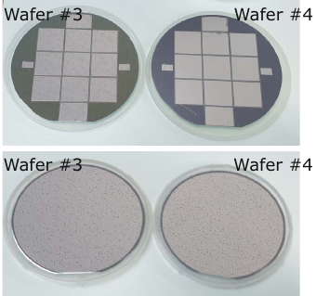
Perspectives for detectors for low-energy nuclear physics
10
NuPECC LRP2024-WTG-Detectors and Exp. Techniques
INDRA FAZIA: Italy, France, Spain, Poland, South Korea
FAZIA consists of 12 (+4 spare) blocks, each featuring 16 three-layer telescopes. Two Silicon layers (300micron+ 500 or 750micron) are followed by 10cm thick CsI(Tl) crystals. All electronics is mounted under vacuum next to the detectors. The detector is capable to detect and identify LCP from 4 to 200 MeV and ions up to above 4GeV, allowing full isotopic separation up to Z=22-24
2012-2018: construction phase. Several experiments on isospin transport and reaction channel characterization have been performed at LNS with the FAZIA modules in stand-alone configuration.
Since 2019, after the coupling with INDRA, other two main campaigns have been done, using Ar and Ni beams from 32 to 74MeV/u. Quasi-Projectile properties and the midvelocity emissions to verify the isospin equilibration, relevant reaction timescales, EOS properties.
New MoU in 2023 until 2027
New thinned 150micron korean wafers (2023)
The collaboration is now developing Si layers of different thicknesses in cooperation with
the Korean group. Lower the detection thresholds for the low-E beams from ISOL facilities
(e.g. SPES, SPIRAL2); thinner sensors (30-150micron); experiments at higher energies
(above 100MeV/u) and thicker Si-layers are also being under development (1mm)

Slide 11
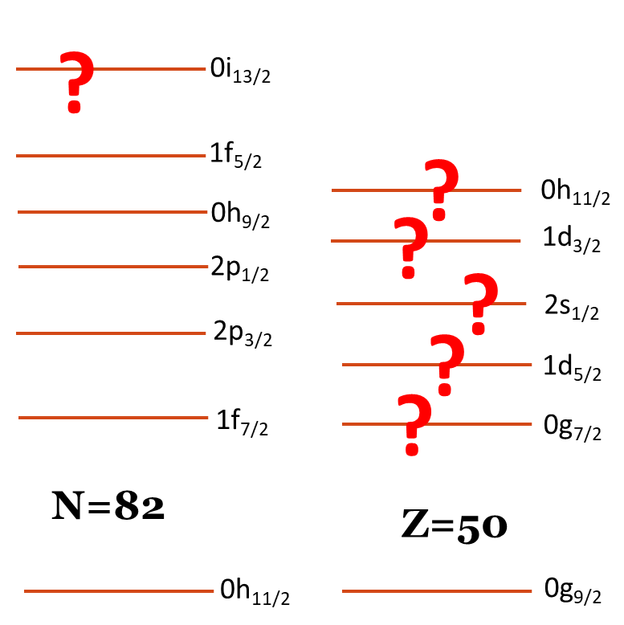
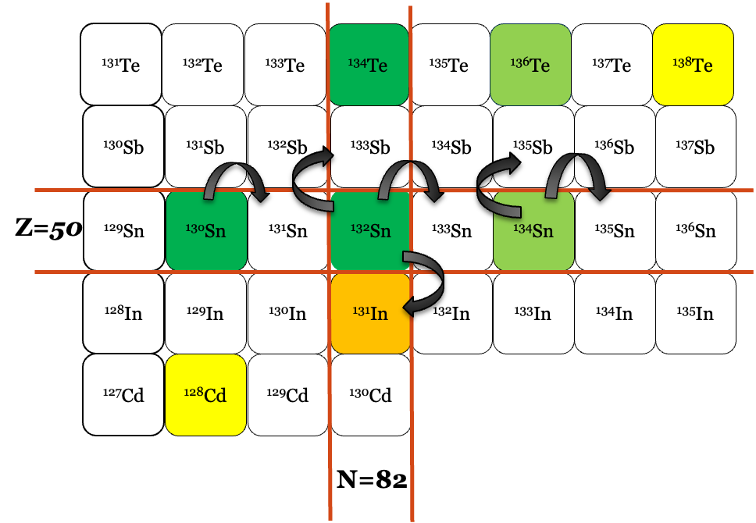
Perspectives for detectors for low-energy nuclear physics
11
NuPECC LRP2024-WTG-Detectors and Exp. Techniques
Segmented Si dector arrays
Example:
Transfer on SPES beams
Physics case
Direct transfer reactions to
probe the shell structure
Inelastic scattering
for resonances
Poor knowledge of shell structure for both protons and neutrons
Theoretical ab-initio calculations start to become available

Slide 12
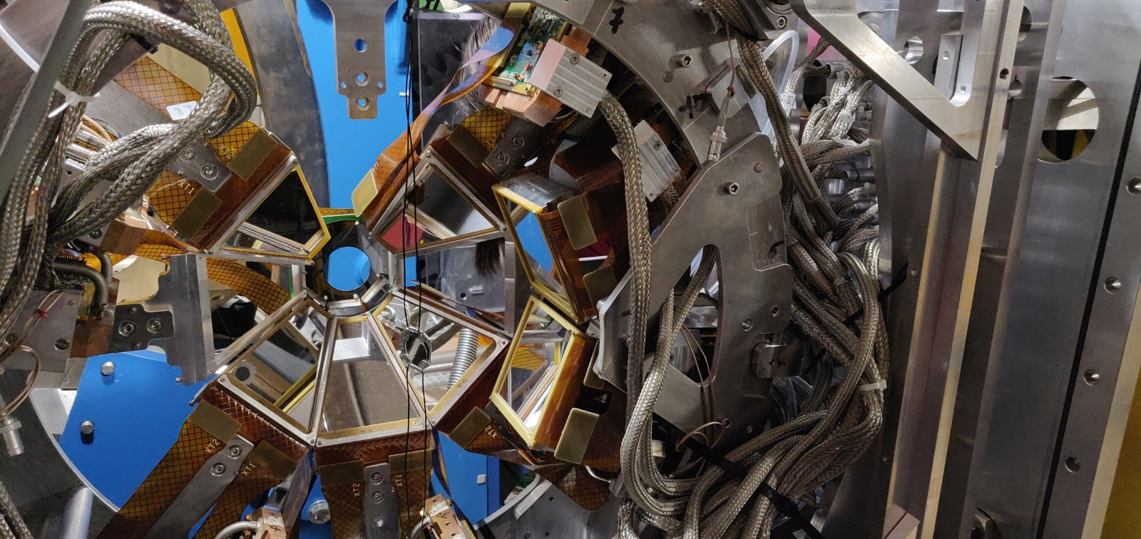
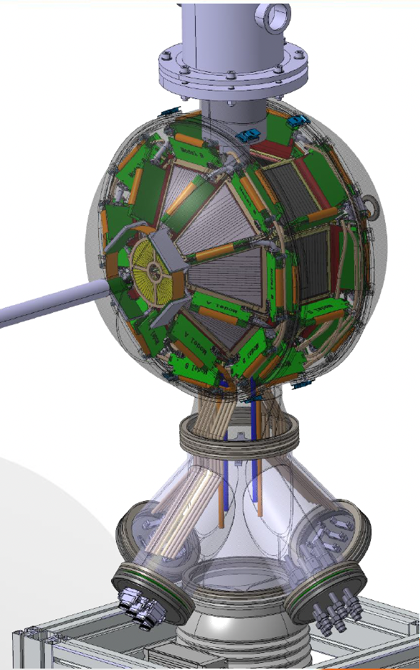
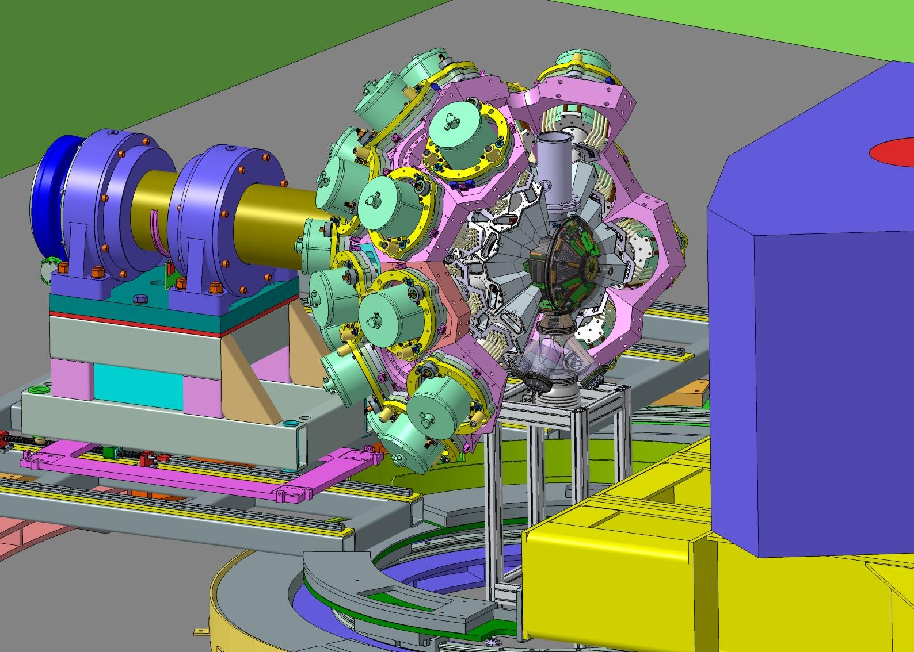
Perspectives for detectors for low-energy nuclear physics
12
NuPECC LRP2024-WTG-Detectors and Exp. Techniques
GRIT
4𝜋 Si array
(France-Italy-Spain-UK)
Granularity, Resolution, Identification, Transparency
Designed to be fully compatible
with AGATA inner 23 cm radius
Compatible with
cryogenic ^{1,2}H, ^{3,4}He targets
Trapezoidal, square and annular detectors
800 um strip pitch
PSA for light particles id

Slide 13
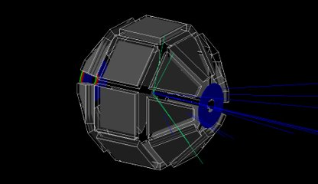
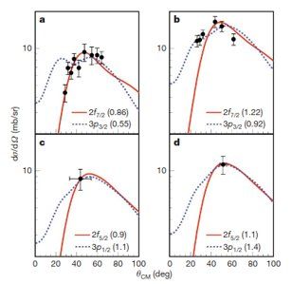
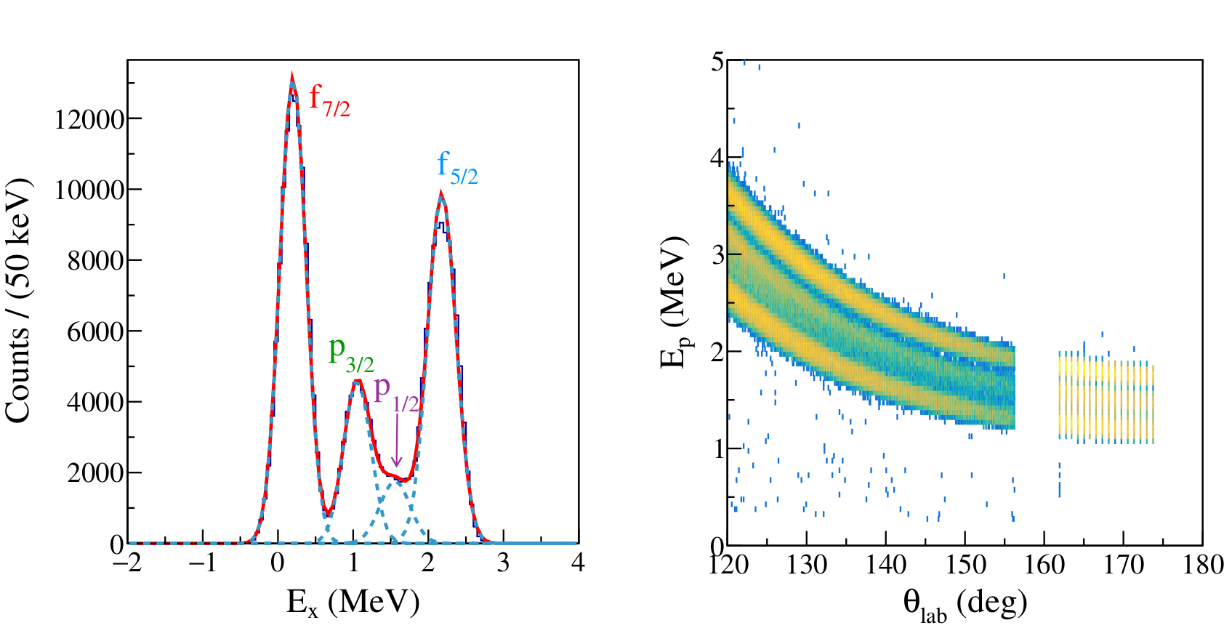
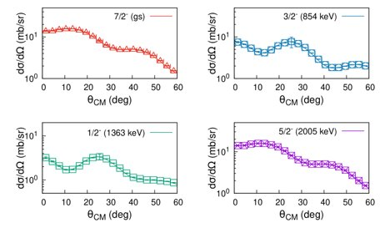
Perspectives for detectors for low-energy nuclear physics
13
NuPECC LRP2024-WTG-Detectors and Exp. Techniques
Full simulation package devoloped
K. L. Jones et al., Nature 09048 (2010) 454
A. Matta, et al., J. Phys. G: Nucl. Part. Phys. 43 (2016) 045113
E* distribution
Kinematic lines
GRIT@SPES
Possibility to do precision measurements to benchmark theoretical models

Slide 14
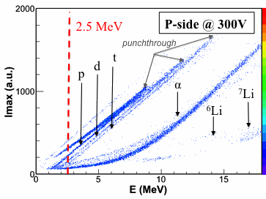
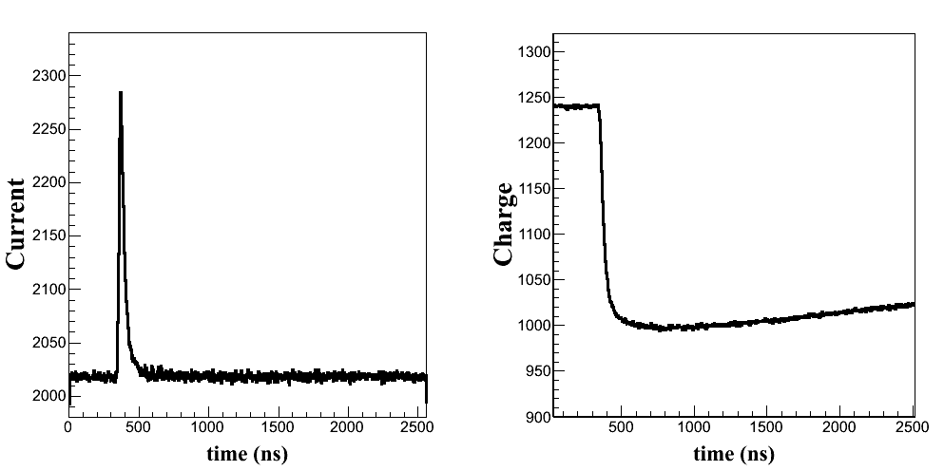
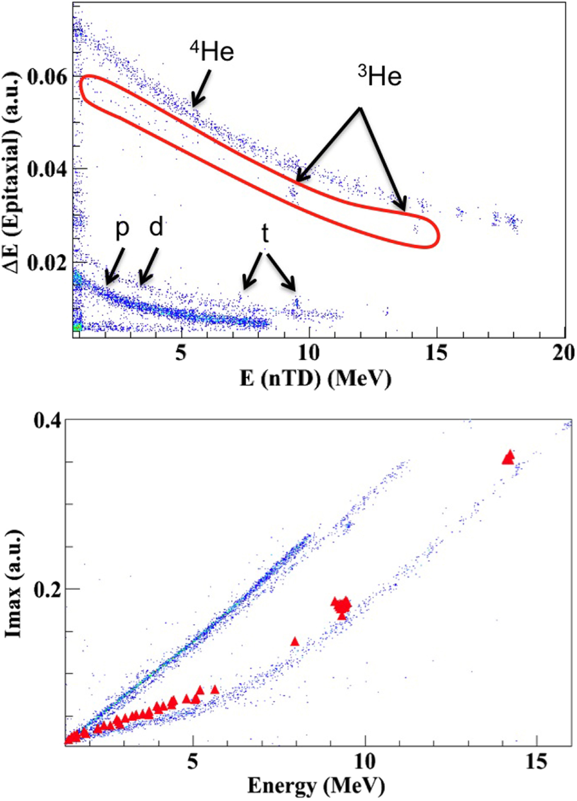
Perspectives for detectors for low-energy nuclear physics
14
NuPECC LRP2024-WTG-Detectors and Exp. Techniques
PSA for GRIT
Test experiment
(ALTO tandem)
⁷Li + ¹²C @ 35 MeV
The most important development planned is in digital PSA
FEE with embedded PSA
PLAS : chip with analog memories with a sampling frequency of 200 MHz.
Together with Asics preamp and BEE, system totally triggerless
PSD for Z=1,2 particles
Current
Imax
GRIT: challenge of dig. of ~7k channel, in vacuum, with only 48 ADCs
Single ADC for many channel
Need for an analog memory
Shared output lines to achieve low dead time
Charge
E=Qmax
Assie et al, NIMA 908 (2018) 250–255
Time (ns)

Slide 15
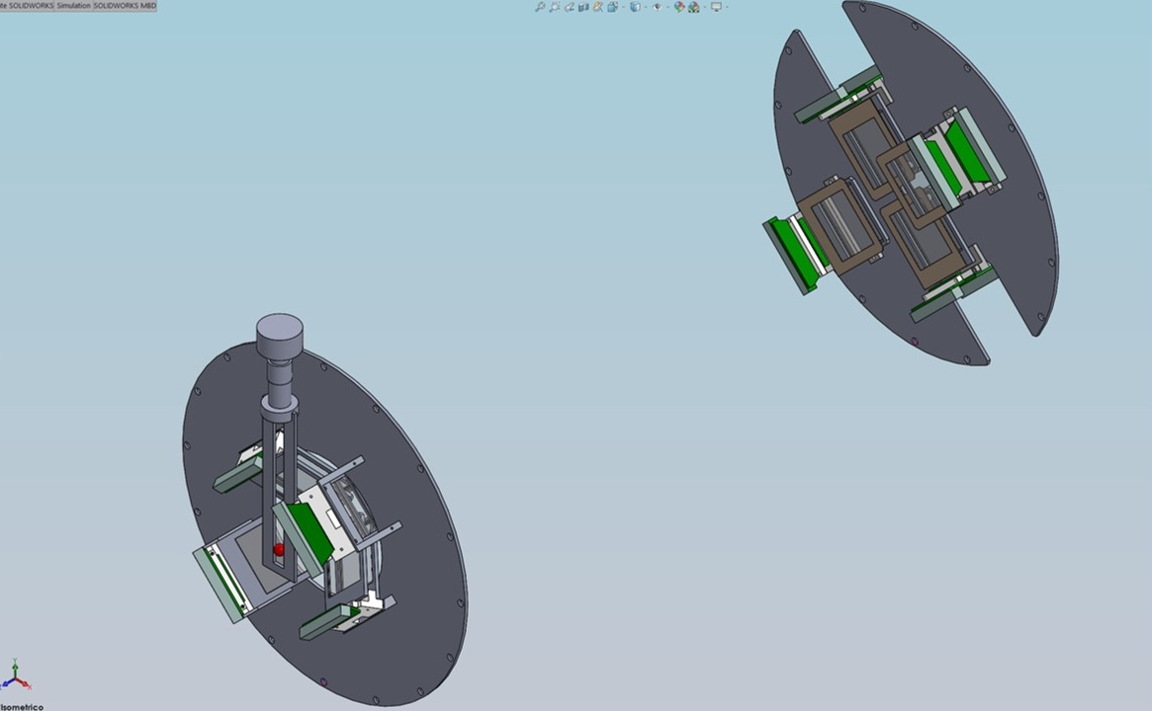
Near Far Silicon Telescope Array
Perspectives for detectors for low-energy nuclear physics
NuPECC LRP2024-WTG-Detectors and Exp. Techniques
Detector arrays for nuclear astrophysics
Large High-resolution Array of Silicon for Astrophysics
Characteristics:
8 telescopes with DSSSD
Measurement in a very forward direction
Versatility & portability
Optimized for reaction with 3-body in the exit channel
High energy and position resolution
Characteristics:
Wide angular range coverage (almost 80% of 4π in final configuration)
Low energy threshold
Compactness useful to couple it with ancillary detectors (neutron arrays)
High energy resolution
Angular resolution allows for kinetic identification of the reaction channels
Upgrades & new developments:
Purchase of different thickness detectors to increase the versatility
Exploring the possibility to build a monolithic telescope to decrease the threshold
Study of the maximum rate acceptable
Developing of devoted simulations
Upgrades & new developments:
Purchase of second lamp and/or different thickness detectors
Exploring a possible double sided silicon configuration for increasing the position resolution
Study of a pulse shape analysis at low energy range
Developing digital ACQ
Physics Letters B, 826,136917(2022)
Perfectly suited for Trojan Horse Method experiments
Perfectly suited for direct measurement in nuclear astrophysics
Notes:
Energy <1% Position res 3mm (dimensione strip) Minimum angle 2°

Slide 16
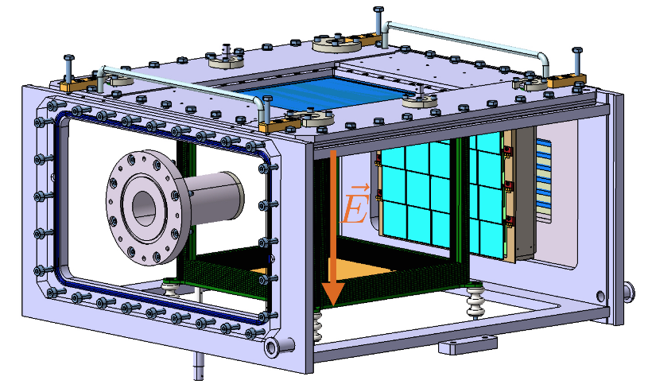
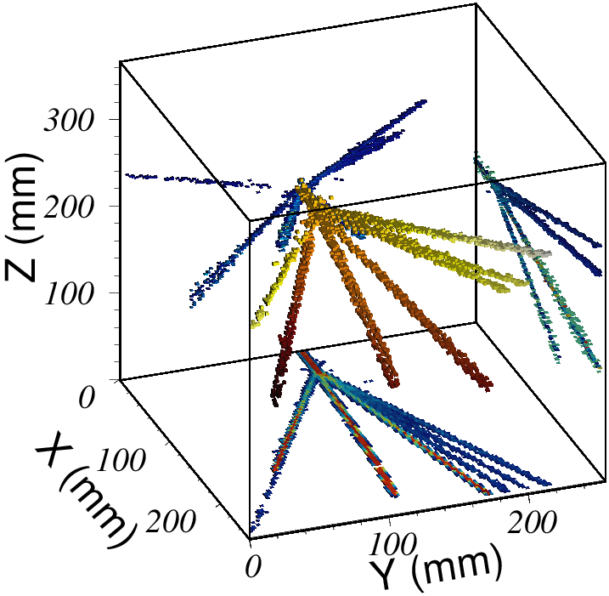
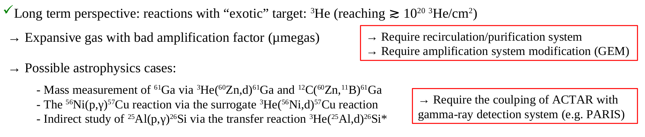
Perspectives for detectors for low-energy nuclear physics
16
NuPECC LRP2024-WTG-Detectors and Exp. Techniques
ACTAR
Active target: (low gas pressure) detector in which the atoms of the gas are used as a target
Study of excitation functions (resonant scattering, etc...)
Reactions with very negative Q-value in inverse kinematics
Reactions with (very) low intensity beams
Time Projection Chamber mode
(eg: proton decay )
550 mm
Drift region: principle
Transparent to particles on 4 sides
→ Wire field cage
Homogeneous vertical drift electric field
→ Double wire field cage: 2 mm/1 mm pitch
300 mm
Amplification region: principle
Bulk Micromegas (CERN PCB workshop)
Local gain reduction via pad polarization
Electronics: GET
GET electronics:
512 samples ADC readout depth x 16384 pads
→ volume sampling in 8 Mega voxel
adjustable gain, peaking time, individual trigger: pad per pad

Slide 17



Perspcectives for detectors for low-energy nuclear physics
17
NuPECC LRP2024-WTG-Detectors and Exp. Techniques
NUMEN: new focal plane detectors
New low-pressure gas tracker
Low pressure operation (Isobutane, tens of mbar)
High resolution measurement of the track coordinates
horizontal position X_{foc} resolution 0.6 mm (FWHM)
horizontal angle θ_{foc} resolution 0.3° (FWHM)
vertical position Y_{foc} resolution 0.7 mm (FWHM)
vertical angle φ_{foc} resolution 0.7° (FWHM)
MHz counting rate for the NUMEN experiment
The PID tower
ΔE stage SiC , thickness 100 μm - E stage CsI (Tl) thickness 5 mm
Simple and Robust
Assembly of several THGEM elements stacked together
Multiple Thick Gas Electron Multiplier (THGEM)
Stripped anode
Multiplication region
Incident ion
Drift region
Cathode

Slide 18


Perspectives for detectors for low-energy nuclear physics
18
NuPECC LRP2024-WTG-Detectors and Exp. Techniques
Zero Degree detection for exotic beams
Needed for RIB identification from nuclear reactions with post-accelerated beams
Separate the reaction products from the unreacted beam and fusion-evaporation residues.
Exact reaction products emittance has to be looked at for chamber size and angular resolutions needed
A special care has to be taken on the minimization of material thicknesses
X,Y reconstruction is also mandatory for best time and energy resolution
Heavy ion recoil separator
Superconducting storage ring:
Primary beam suppression < ~10⁻¹²
100 % transport efficiency
Mass resolution > 1/300
Large acceptance ~ 100 mrad
Gas-filled mode
Focal plane detector:
Position sensitivity ~ 1 mrad (scattering angle)
Particle identification (A, Z)
Eloss, Time of Flight, Pulse shape
Time resolution ~ ns
Energy resolution < 100 keV
ZDD for LISE@GANIL
Include a FAZIA configuration (with central hole) to identify A up to Z=25
Courtesy of I. Martel

Slide 19
Perspectives for detectors for low-energy nuclear physics
19
NuPECC LRP2024-WTG-Detectors and Exp. Techniques
FAZIA: Italy, France, Spain, Poland, South Korea
FAZIA consists of 12 (+4 spare) blocks, each featuring 16 three-layer telescopes. Two Silicon layers (300micron+ 500 or 750micron) are followed by 10cm thick CsI(Tl) crystals. All electronics is mounted under vacuum next to the detectors. The detector is capable to detect and identify LCP from 4 to 200 MeV and ions up to above 4GeV, allowing full isotopic separation up to Z=22-24
2012-2018: construction phase. Several experiments with the FAZIA modules in stand-alone configuration at LNS.
Since 2019, coupling with INDRA at GANIL. Quasi-Projectile properties and the midvelocity emissions to verify the isospin equilibration, relevant reaction timescales, EOS properties.
New MoU in 2023 until 2027
The collaboration is now developing Si layers of different thicknesses in cooperation with
the Korean group. Lower the detection thresholds for the low-E beams from ISOL facilities
(e.g. SPES, SPIRAL2); thinner sensors (30-150micron); experiments at higher energies
(above 100MeV/u) and thicker Si-layers are also being under development (1mm)
New thinned 150micron korean wafers (2023)

Slide 20

Perspectives for detectors for low-energy nuclear physics
20
NuPECC LRP2024-WTG-Detectors and Exp. Techniques
CHIMERA
Ancillary hodoscope for neutrons, 𝛾-ray and charged particles detection
Future CHIMERA line tagging for FraISe beams:
array of detectors based on SiC technology, single detection unity pad 5 × 5 mm2 and 100 µm thick, 72 channels with Δt ≈ 200 ps (≈0.1% precision on energy for 20 m base-of-flight) with 200 µm inter-pad dead zone, 10% dead area
Candidate: The plastic scintillator EJ276-Green Type (ex EJ299-33) (3x3x3cm³)
1 cluster: 4 consecutively cubes (stack configuration)-> 3x3x12 cm³ (64 detection cells)
Reading the light signal: Si-PM and digitalization
Modular, reconfigurable (in mechanic and electronic)
Discrimination of n/γ from PSD (but also light charged particles)
Energy measurement from ToF (Δt≤1 ns with L_{ToF}≈1÷1.5m)
5 mm
Side View
30 mm
60 mm
Front-end: Custom multi/channel ASIC with charge preamplifier configuration and analog preprocessing optimized for amplitude and time measurements
Full waveform digitizers and synchronization with CHIMERA/FARCOS DAQ

Slide 21





Perspectives for detectors for low-energy nuclear physics
21
NuPECC LRP2024-WTG-Detectors and Exp. Techniques
Neutron detectors for nuclear spectroscopy
NEDA
CLYC
Versatile neutron detector designed to be coupled to gamma-ray arrays
Neutron detection is based on the liquid scintillator EJ301 with good neutron-gamma discrimination capabilities.
FEE fully digital system:
200 MHz and ENOB 11,3
Global Trigger System - GTS
Fast Neutron Spectroscopy
³⁵Cl(n,p)³⁵S
- Q-value = 0.6 MeV
³⁵Cl(n,α)³²P
Q-value = 0.9 MeV
⁶Li (n,α)t
- Q-value = 4.78 MeV
Matrix TOF vs Energy deposited in CLYC
Time of Flight distinguish between (n,α) and (n,p) reactions
Energy deposited in CLYC does not distinguish between (n,α) or (n,p)
NEDA
Matrix PSA vs Energy deposited in CLYC
Red => (n,p) reactions
Green => (n,α) reactions
Charge integration or FFT techniques can distinguish in some cases (n,p)
from (n,α) events
AGATA
Beta-delayed neutron spectroscopy

Slide 22




Perspectives for detectors for low-energy nuclear physics
22
NuPECC LRP2024-WTG-Detectors and Exp. Techniques
Traps for exotic nuclei
The DE(sir)TRAP facility
MORA
MLLTrap
Paul trap with laser polarization
-> D coefficient measurement
-> $β$-𝜈 angular correlation coefficient
-> Shake-off probability in 𝛽 decay
double Penning trap in 7T magnetic field
-> mass measurements (DM/M~10⁻⁸) of pure samples
-> In-trap e- and 𝛼 spectroscopy
e⁻ pixel
detector
C. Weber et al., Int. J. Mass Spectrom. 349 - 350, 270 (2013)
Nuclear structure & decay properties
shell evolution, deformation
(super-) heavy nuclei decay spectroscopy
Implementation at ALTO
Fundamental interaction physics
CP-violation, exotic currents, CVC, V_{ud},
atomic physics

Slide 23

Perspectives for detectors for low-energy nuclear physics
23
NuPECC LRP2024-WTG-Detectors and Exp. Techniques
FINAL REMARKS ON PERSPECTIVES
Detectors for low-energy nuclear physics must cover a wide range of observables for a complete characterization
of nuclear reactions and decays:
- 𝛾 rays
- light particles
- heavy ions
- neutrons
New materials/fabrication techniques being developed.
Tendency to go towards large-solid angle coverage (4𝜋), high-granularity arrays: large amount of electronic channels, challenging on-line data processing for e.g. PSA.
Use of composite detector setups made of different large detector arrays.
Large scale collaborations (EU and beyond)
PROBLEM: Timing of projects and electronic/technology obsolescence

Slide 24
Perspectives for detectors for low-energy nuclear physics
24
NuPECC LRP2024-WTG-Detectors and Exp. Techniques
MANY THANKS TO:
Many inputs from the communities involved in low-energy nuclear facilities like LNL, LNS, GANIL, ALTO…
Emmanuel Clement, Thomas Roger, Olivier Sorlin, Bertram Blank, Didier Beaumel, Marlene Assié,
Aurora Tumino, Enrico Fioretto, Daniele Mengoni, Franco Galtarossa, José Javier Valiente Dobon, Giovanni Casini,
Silvia Leoni, Franco Camera, Giovanna Benzoni et al. contributed directly on behalf of their collaborations
and institutions.

Slide 25
Perspectives for detectors for low-energy nuclear physics
25
NuPECC LRP2024-WTG-Detectors and Exp. Techniques
THE END

Slide 26
Perspectives for detectors for low-energy nuclear physics
26
NuPECC LRP2024-WTG-Detectors and Exp. Techniques

