Slide 1
LRP 2024
Analysis of the community input on
High Energy Nuclear Physics

Slide 2
Community input analysis
Community input (~150 entries) divided between:
P. Gasik - Part I - https://sf.gsi.de/f/ceea4117f25e44a9a472/?dl=1
S. Masciocchi - Part II - https://sf.gsi.de/f/98dcfc11c1aa42508f9b/?dl=1
T. Peitzmann - Part III - https://sf.gsi.de/f/2dd8d32135ea4b22bca5/?dl=1
V. Puill - Part IV - https://sf.gsi.de/f/bf00859f5bf6436f95e2/?dl=1
J. Stroth - Part V - https://sf.gsi.de/f/583a10b431df4ccf889d/?dl=1
(~30 entries each)

Slide 3
Part I

Slide 4
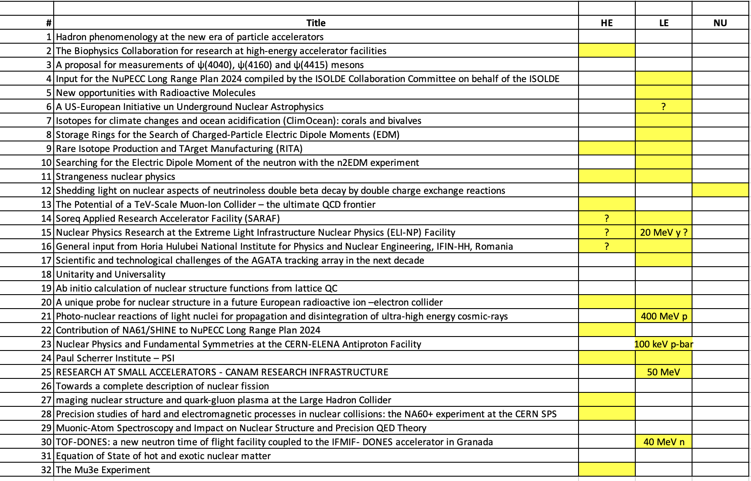
Preliminary check
13/32 discusses high-energy NP.

Slide 5

Detailed analysis
The Biophysics Collaboration for research at high-energy accelerator facilities
The production of very high energy (~10 GeV/n) heavy ions is very important for
  studies in space radiation protection (biology and microelectronics),
  particle radiography and theranostics,
  particle therapy, and for the production of new radioisotopes (high-energy radioactive ion beams and ultra-high dose rates)
  measuring the biological effectiveness of the ions and to measure shielding effectiveness against cosmic rays.
  new solutions in particle therapy.
    protons with energies ~GeV and the PRIOR setup: body tumors can be visualized with high spatial and temporal resolutions
    The PaNTERA @ FAIR: possibility to use 4.5 GeV protons for radiography and tomography with sub-mm resolution.
  The high-intensity offers even more opportunities for particle therapy. The possibility of using very high energies (> 1GeV/u) permits the exploration of new avenues in charged particles minibeam radiotherapy.
    FLASH radiotherapy: ultra-high dose rates (>40 Gy/s) spare normal tissue but do not compromise tumor control in animal models
    Radioactive beams therapy (BARB)
TWG-6 + Scientifc TWGs
TWG-8

Slide 6
Rare Isotope Production and TArget Manufacturing (RITA)
importance of isotope and target production for nuclear physics research in general
Strangeness nuclear physics
Light hypernuclei: WASA-FRS at GSI/FAIR, P73/P77 at J-PARC,
ALICE during LHC Run3 and Run4, experiment at ELPH at the Tohoku University
Hypernuclei from RIB: HYDRA@R3B
S=2 hypernuclei: PANDA, CBM
Multi-particle correlations: ALICE, CBM
Kaonic atoms: SIDDHARTA-2 at DAFNE, E57 at J-PARC
The Potential of a TeV-Scale Muon-Ion Collider – the ultimate QCD frontier
TWG-6 infrastructure
No Detector (nor experimental techniques) R&D mentioned
Soreq Applied Research Accelerator Facility (SARAF)
TWG-6 infrastructure
Medium energies (40 MeV p and d)
No Detector (nor experimental techniques) R&D mentioned
High-energy not mentioned explicitely
General tool
Experiments

Slide 7

Nuclear Physics Research at the Extreme Light Infrastructure Nuclear Physics (ELI-NP) Facility
TWG-6 infrastructure
No specific detector (nor experimental techniques) R&D mentioned
Several laser-driven nuclear physics applications, e.g. X-ray imaging, radiotherapy, irradiaiton for space industry and medical science,
General input from Horia Hulubei National Institute for Physics and Nuclear Engineering
TWG-6 infrastructure
No Detector (nor experimental techniques) R&D mentioned
A unique probe for nuclear structure in a future European radioactive ion–electron collider
TWG-6 infrastructure
Experimental tool/technique mentioned: ion traps
Low/high energy? 500-700 MeV
Contribution of NA61/SHINE to NuPECC Long Range Plan 2024
High-energy HI experiment
No Detector (nor experimental techniques) R&D mentioned
Paul Scherrer Institute – PSI
TWG-6 infrastructure
Experiments: MEG II and Mu3e, n2EDM, HyperMu, muX, MIXE, muEDM, PIONEER, LEMING, CHRISP, PIF@CHRISP (rad. damage & ele. component testing)
Discussed as separate contributions

Slide 8
Imaging nuclear structure and quark-gluon plasma at the Large Hadron Collider
Scientific TWGs + TWG-6 (Infrastructure) to discuss impact on LHC schedule
Precision studies of hard and electromagnetic processes in nuclear collisions: the NA60+ experiment at the CERN SPS
Experiment
Detector development and R&D: vertex spectrometer (MAPS) - R&D with ALICE-ITS3, 3GEM and/or MWPCs for muon spectrometer, toroid
The Mu3e Experiment
Experiment
No detector R&D was mentioned. HV-MAPS is certainly the key technology.

Slide 9
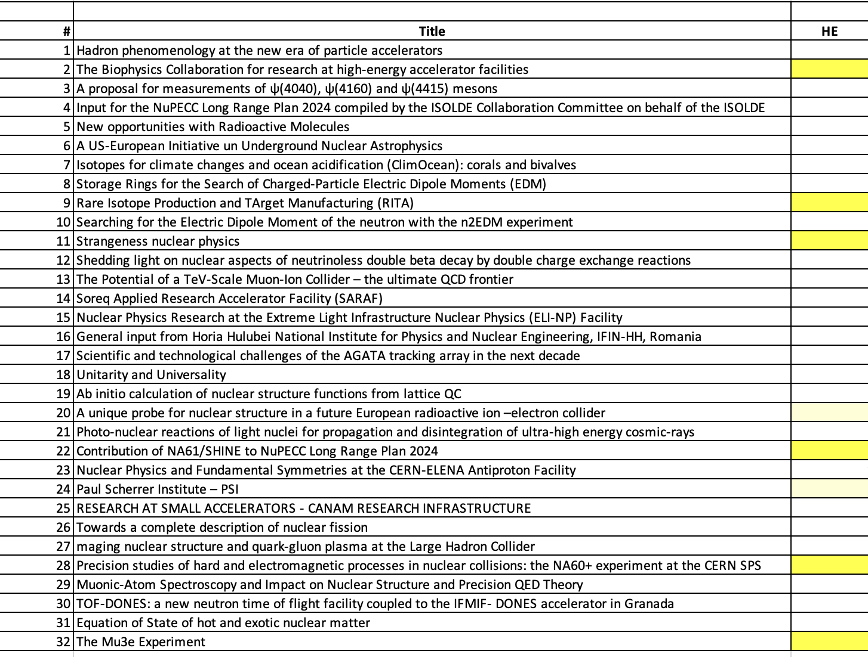
Detailed analysis Part I
6-7/32 discusses R&D on detectors/techniques for the high-energy NP.

Slide 10
Part II

Slide 11
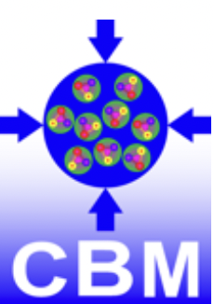
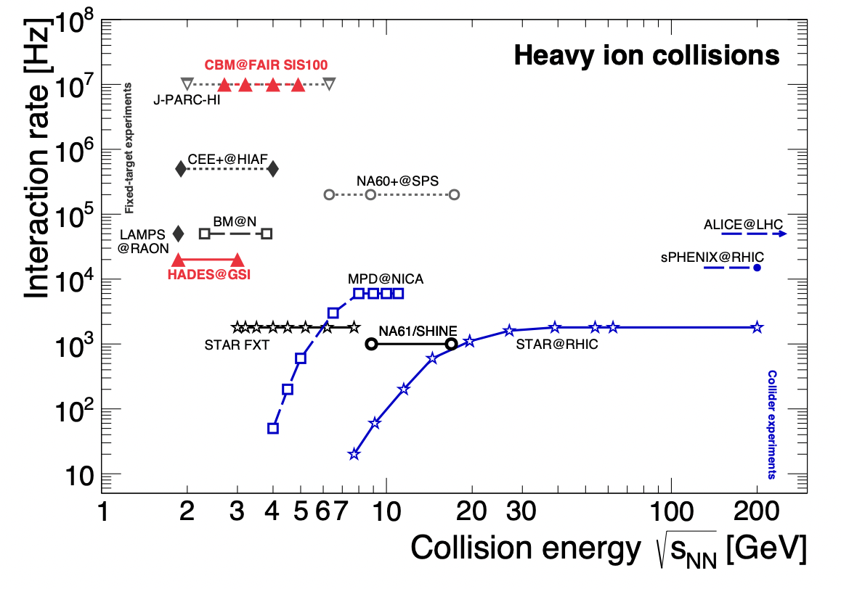
The CBM experiment at FAIR
Explore the phase structure of strongly interacting matter at large net-baryon densities and moderate temperatures with heavy-ion collisions at √s_{NN}=2.7-4.9 GeV
Key: superb rate capability
Data acquisition: full free-streaming system without hardware trigger (peak collision rates of 10 MHz)
Self-triggered readout electronics, high-speed data processing and acquisition, fast algorithms for online selection
Radiation hard detectors
Key: detector technology
CMOS monolithic active Pixel Sensor (CPS)
→ 50 μm thick, 5 μm resolution, <100mW/cm² power diss.
→ see dedicated submission to the LRP
Fast timing by low-gain avalanche detectors (LGAD)
→ 20-30 ps time resolution

Slide 12

Heavy-ion program in CMS at the LHC
Exploitation of the ultrarelativistic heavy-ion program at the LHC: with a factor of >10 increase in integrated luminosity, precise studies of the QGP become possible
Collision systems: Pb-Pb (at 5.5 TeV, 13 nb⁻¹), p-Pb (at 8.8 TeV, 1.2 pb⁻¹), plus lighter ions (larger nucleon-nucleon luminosity, small systems, heavy flavors, etc.)
Detector upgrades for the HL-LHC era:
Tracker upgrades → increased charged particle tracking pseudorapidity acceptance
Upgraded Zero Degree Calorimeters → improved trigger and selection of ultra-peripheral collisions (nPDFs, photon-photon interactions for precise QED, BSM physics)
Minimum Ionizing Particle Timing Detector (from Run 4, 30 ps timing resolution) → particle identification (pion, kaon, proton) at low momentum over 6 units in rapidity, to improve heavy flavor and neutral strange hadrons reconstruction
Leveraging upgrades to data-acquisition systems → unprecedented larged samples of minimum bias samples for precision measurements (e.g. small systems and high multiplicities, rapidity dependence of correlations)
High granularity tracker and calorimeter + new algorithms → investigation of jet (sub-)structure

Slide 13
Heavy-ion program at the LHC
Relevant synergies
With other collider projects:
  RHIC at BNL (sPHENIX)
  EIC (nPDFs, initial state, jet (sub-)structure)
With other strategy processes
  Snowmass 2022
  European and US strategy for particle physics
  US long-range plan for nuclear physics

Slide 14
Many-body QCD physics – heavy-ion physics
Plans of the French community (CNRS, CEA, universities)
Not much at all about detectors
LHC heavy-ion program: ALICE, CMS, LHCb (key role played by France in HI, collider + fixed target)
  ALICE upgrades for Run 3: ITS2 tracker, muon-forward tracker, electronics in muon systems, new Offline-Online software framework
  Involvement in the ALICE and LHCb upgrades in LS3 and LS4 (no details)
HADES at GSI, baryon-rich matter
Future at low energy, interest in 3 projects: CBM/FAIR, NA60+/CERN, J-PARC-HI

Slide 15
Nuclear physics at LHCb: future plans and prospects
Participation to HI program at LHC (mostly p-Pb so far)
plus fixed-target program with SMOG : pNe, pAr, PbNe, and several more
Upgrades for Run 3: (completed)
new pixel VELO, new tracker of Scintillating Fibers
new gas target SMOG2 (larger effecive areal density, more gas species)
Beyond Run 4: second large upgrade
Next upstream tracker upstream of the magnet will use a pixel-based design to handle sensibly higher multiplicity at HL-LHC
MIGHTY tracker downstream of the magnet also with pixels in the innermost region
New PID systems
Addition of magnet stations to improve efficiency of low momentum tracks
All this will make access to full Pb-Pb collision program and to lowest Bjorken-x values in the lab

Slide 16
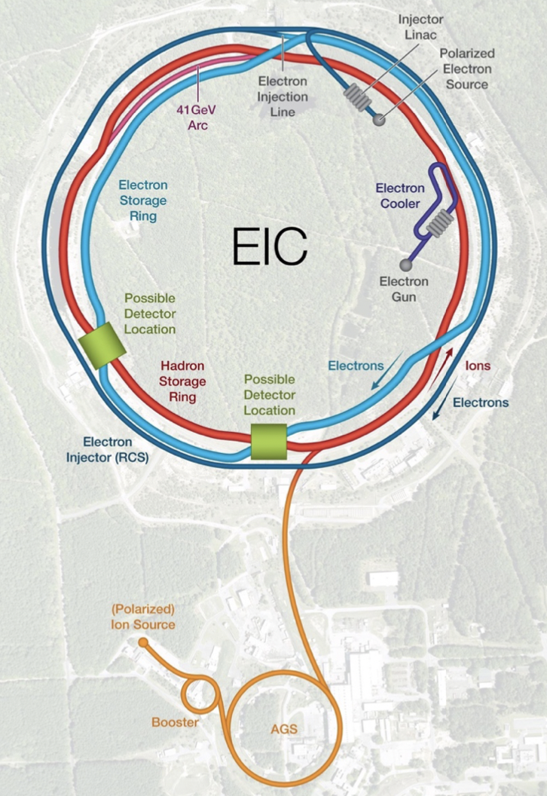
Electron Ion Collider (BNL, JLAB) – 1/2
(Part on frontiers of accelerator technology, see page 2 of contribution)
Detector technology:
2011: generic detector R&D program leading to technology choices for the EPIC design
summer 2022: R&D reopened towards potential upgrades to EPIC and a potential second detector
MAPS: collaboration with ALICE to develop the ITS3 sensor and modify it, as necessary. 65 nm technology: wafer-size sensors for the vertex layesr, smaller version for barrel layers and disks
μRWell: reduced material budget, simpler construction, and lower cost when compared with other MPGD technologies
hpDIRC: cost-optimized high-performance DIRC + compact readout electronics for the fast detection of single photons with high-density sensors. In collaboration with the PANDA DIRC
dRICH: dual RICH (gas and aerogel radiators) in synergy with ALICE, including study of the single photon response of SiPM coupled to the ALCOR readout electronics
Environment-friendly Radiator Gases for RICH detectors to avoid fluorocarbons, and favor argon pressurized at a few bar

Slide 17
Electron Ion Collider (BNL, JLAB) – 2/2
Homogeneous Electromagnetic Calorimetry: in collaboration with GSI/PANDA, develop
high quality PbWO4 crystals. Pursue a cost-effective solution with scintillating glass, as
well as a high-density glass with good production of both Cherenkov and scintillating light
for very cost0effective hadronic calorimetry
AC-LGAD: developments to reduce the active volume thickness and optimize implantation parameters to achieve a time resolution below 20 ps. One important effort specific to the ToF is to develop long strip AC-LGAD sensors to minimize the material budget. + readout electronics
Photosensors: highly pixelated photodetectors that are capable of operating in fields of up to 2T. This problem is most critical for RICH detectors and is not yet fully solved. The objective of ongoing R&D with strong collaboration from INFN Italy, is to mitigate technical, cost, and schedule risk related to readout sensors of Cherenkov detectors. R&D activities focus on the pixelization and improvement of the field resistance of LAPPDs and HRPPDs

Slide 18
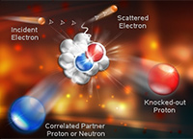
Hadron physics at JLAB and EIC
Plans of the French community (CNRS, CEA, universities)
JLab: CEBAF 11 GeV electron beam (+LHC collider and fixed target)
  2022-2035: Jlab 12 GeV upgrade to probe deeper in the nuclear structure
  Experiments dedicated to exclusive processes off protons in the Halls B and C
    New neutral particle spectrometer (NPS) for the Hall C experiments
    Vertex tracker made of Micromegas detectors for the CLAS12 Hall B spectrometer
    New neutron detectors for CLAS12
    Use of unpolarized and polarized (longitudinally and transversally) proton and deuterium targets
    Recoil nucleus tracked by ALERT, a cylindrical chamber with finely segmented scintillators surrounding the chamber
Anticipated participation to the EIC
  French groups involved in R&D of calorimetry, tracking and electronics
  Interest in second interaction region and experiment at the EIC
Theory

Slide 19
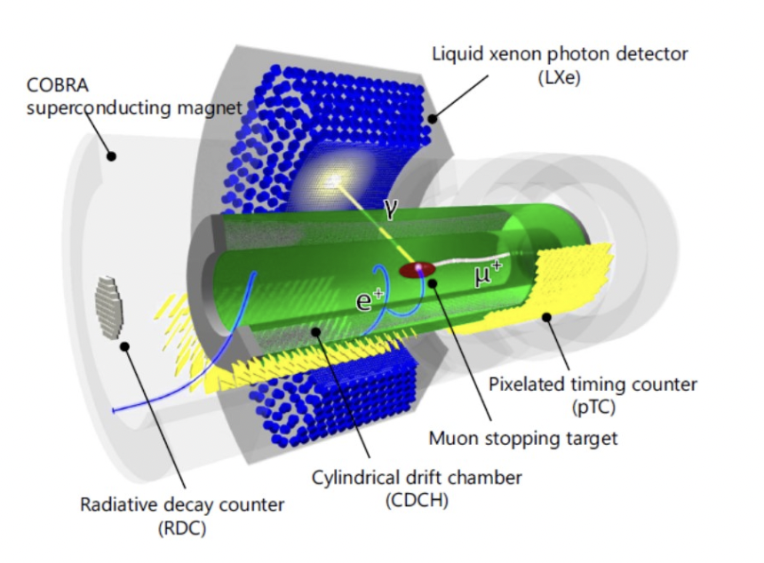
MEG II at PSI: search for the μ → e𝛾 decay
Search for charged lepton flavor violating processes, BSM physics
Extremely high resolution on positron and photon detection to reject background contributions
Photons measured by a 2.7 ton ultra pure liquid xenon detector Lxe
The vacuum ultraviolet (VUV) light ( = 175 ± 5 nm) emitted by 900 L of continuously purified liquid xenon is read by 4092 12⇥12 mm2 SiPMs on the photon entrance face and by 630 PMTs on the other faces, directly submerged in the liquid xenon. The high density of SiPMs on the photon entrance face ensures a good uniformity of the light collection.
Positrons tracked in a specially designed gradient magnetic field (COBRA) by low material drift chambers
new, very low mass, single-volume cylindrical (1.91 m long, inner radius 17 cm and outer radius 29 cm) drift chamber (CDCH) filled with a gas mixture of a 90:10 He - iC4H10 with small percentages of isopropane (1.5%) and O2 (0.5%). CDCH is equipped with 1728 gold plated tungsten anodic wires, 7680 40 μm and 2496 50 μm silver plated aluminum wires that are mounted in a stereo geometry to allow a three-dimensional track reconstruction of positrons
Positrons times by scintillation counters
new pixelated timing counter (pTC) based on 512 scintillator tiles read out by SiPMs. A superior positron timing resolution (of the order of 30 ps) is obtained from measurements by an average number of eight hit tiles per positron
In-situ monitor and calibration during data taking

Slide 20
Belle II Collaboration input
Hadron spectroscopy, inputs to g-2, fragmentation functions, proton form factors, measurements of α_{S} and hadronic tau decays
With an hermetic spectrometer (6-layer vertex detector) surrounded by PID detectors (including a new Cherenkov detector based upon time-of-propagation in the radiation with 40 ps timing resolution), an electromagnetic calorimeter, muon detectors
Nothing on future upgrades (which are notable for detectors, e.g. pixels)

Slide 21
Detailed analysis Part II
6/30 contributions discuss R&D
3/30 related to HE NP but without clear reference to detector R&D

Slide 22
Part III

Slide 23
Detector-related contributions, but not too strong perspective on concrete R&D

Slide 24
HADES White Paper
J. Stroth
Planned HADES program at SIS 18 and beyond, future running jointly with CBM
While clearly a detector-oriented contribution, there is no obvious detector R&D proposal – the new aspects will likely be rather in the combination with CBM, and detector R&D done there.

Slide 25
End-to-End Optimization of Detectors
T. Dorigo – MODE Collaboration
Software architecture for optimization of detector design
Likely relevant for future high-energy physics detectors, but difficult to oversee the practical benefit.

Slide 26
Physics programs in need of facilities and some unspecific detectors, no detector R&D

Slide 27
Hadron Interaction (N. Zachariou)
Hadron Spectroscopy (N. Zachariou)
Hadron Structure (R. Montgomery)
Three contributions on different aspects of hadron physics from closely related groups. (overlap with M. Battaglieri)
Plea for programs at facilities (EIC, Jlab, MAMI, ELSA, CERN), on detectors only relatively general suggestions, with the exception of AMBER at CERN (in Hadron Spectroscopy)

Slide 28
Electron scattering and neutrino programs
V. Pandey
Physics program for lepton-nucleus scattering
Some plea for facilities, nothing specific on detectors

Slide 29
Antinuclei in space
L. Fabbietti
Stresses opportunities with existing and future facilities and experiments.
No case for specific detector development.

Slide 30
Hadron Physics at the energy and intensity frontier
M. Battaglieri
General hadron physics program
(overlap with N. Zachariou et al. )
Plea for programs at facilities (mainly EIC and JLab), very little on detectors

Slide 31
Detailed analysis Part III
2/29 contributions related to hardware (HADES, AMBER), not specific R&D
6/29 related to HE NP (facilities, techniqies) but without clear reference to detector R&D

Slide 32
Part IV

Slide 33
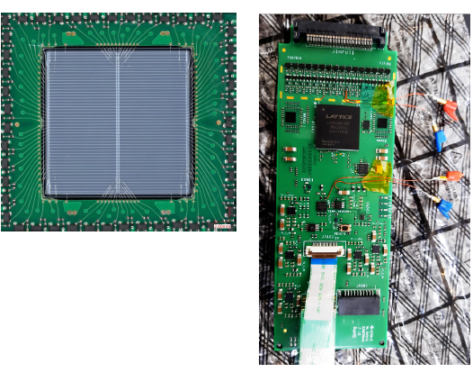
Ultra-fast silicon detectors for nuclear physics and medical applications
Increasing luminosity of particle physics experiments → increasing particle track densities → R&D on 4D-tracking : R&D on Si detector focused on time measurements, enabling simultaneous particle tracking with μm resolution and time-of-arrival measurement with tens of ps
Most promising 4D-tracking detectors are based on the Low Gain Avalanche Diode (LGAD) developed at Fondazione Bruno Kessler (FBK)
Applications :
Prototype start reaction time and beam monitoring system (≈10⁸ p/s/cm² pp - 4.5 GeV protons) for the HADES experiment consisted of two 2 × 2 cm² orthogonally arranged, single-sided LGAD strip detectors with a sensor pitch of 387 µm, a total thickness of 200 µm and a fill factor of ~94% each.
Beam monitor system for the Superconducting Darmstadt Linear Accelerator (S-DALINAC) that resolves the 3.3 GHz time structure of the electron beam (333 ps between the bunches)
New ion imaging concept for ion beam therapy (IBT) based on time-of-flight measurements :
ion computed tomography (iCT) : imaging modality used in IBT to directly determine the stopping power (SP) distribution within the patient
excellent rate capabilities + radiation hardness of LGADs → next generation of iCT scanners
Monte Carlo feasibility studies + first proof-of-principle measurement with the current LGAD system → good results
Futur plans: realize a large-scale LGAD-based 4D-tracking system → substantial R&D activities:
characterisation and usage of the next generation of LGAD strip sensors, which feature a fill factor close to 100%
dedicated module design to maximize the field-of-view, while keeping the material budget at a minimum
development of a fast and compact ASIC that is able to deal with the increased number of readout channels of a large-area particle detector system while still meeting the demanding time precision requirements

Slide 34
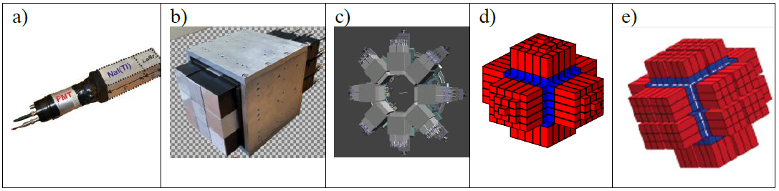
Towards the 4π PARIS gamma calorimeter – scientific case and technical challenges
Photon Array for studies with Radioactive Ion and Stable beams : 4π gamma-ray calorimeter benefiting from recent advances in scintillator technology
“Phoswich” detectors: 2”×2”×2” LaBr3:Ce/CeBr3 scintillators + 2”×2”×6” NaI scintillator+ PMT
→ time resolution of ca. 0.5 ns, energy resolution of ca. 4%
Alternative readout system under development using:
a matrix of 64 SiPMs 6x6 mm
+ dedicated holding structures for the phoswich/clusters
+ dedicated electronics
+ custom DAQ

Slide 35
Development of high-precision, low-mass tracking detectors based on CMOS monolithic Pixel Sensors 1/2
CMOS Monolithic Active Pixel Sensors (CPS) for heavy flavor tagging and low momentum tracking of various experiments of particle and hadron physics
spatial resolution = few μm
time resolution = few μs
thickness = 50 μm
power consumption = 10 mW/cm²
tolerance to radiation doses above 10¹⁴ 1-MeV n_{eq}/cm²
particle rates up to about 100 MHz/cm²
The present R&D on CPS is driven to a large extent by the need to further reduce the material budget of CPS based detector systems.
Development of wafer size thin sensors (≤ 50 μm) that become flexible and may be bent at radii in the order of 2 cm → replacement of the 3 innermost layers of the current ALICE ITS2 (> 10 m²)
Use in the target spectrometer of PANDA or in the R3B experiments would allow for proton tracking, vertex reconstruction and presumably push quality of the experiment to the level not reachable with the planar detectors
Wafer size sensors exceed the reticle size → development of the stitching process (65 nm TPSCo CIS process)
It is anticipated that the additional integration density provided by this 65 nm process may allow to improve the granularity of CMOS sensors. Alternatively, it may serve to improve in-pixel functionalities including time stamping and the data bandwidth, which may be exploited in high rate tracking systems.

Slide 36
Development of high-precision, low-mass tracking detectors based on CMOS monolithic Pixel Sensors 2/2
Possible topics for common R&D and synergies
In order to improve the :
radiation tolerance increased by one order of magnitude,
time stamping
rate capability
For vertex detectors of Belle II, CBM, PANDA & Higgs factories : similar needs and the prototypes are manufactured in the same industrial CMOS process →
common R&D efforts e.g. on understanding and optimizing their spatial resolution and on the origin of the radiation tolerance limits of the specific sensing elements explored
common simulation models
common detector integration techniques studies: fully thinned, mechanically even flexible sensors need to be mechanically supported, rigidly and precisely held in place, thermally cooled and electrically connected without compromising the extremely low material budget the devices require themselves → mechanical and electronic challenges → initiate topical research on pushing forward micro integration technologies like micro channel cooling)
sharing of complex infrastructure and specific equipment
explicit documentation efforts accounting for the perspective of both, technology designers and users

Slide 37
JLab12 Input for NUPECC LRP
research activity pursued by several Italian collaborators at JLab
CLAS12: INFN led the construction of a RICH detector for the kaon identification at momenta above 3 GeV/c that has been just completed (June ’22)
SBS program: Italian physicists have provided significant contribution in the design and implementation of part of the SBS charged particle tracker based on GEM, the readout electronics of all GEM based trackers and the assembling and characterization of the Hadron calorimeter (HCAL) as well the design and constructions of its demanding mobile platform.
Nothing on future plans

Slide 38
The Electron-Ion Collider
The EIC will allow for the exploration of new landscapes in QCD, permitting the “tomography”, or high-resolution multidimensional mapping of the quark and gluon components inside of nucleons and nuclei.
Challenge : the detector must provide coverage for a wide range of center-of-mass energies (between 20 and 140 GeV), and must take full advantage of the collider high luminosity (peak luminosity around 10³⁴ cm), the beam polarization options and the variety of species of the ion beam, opening an era of precision measurements in deep inelastic scattering.
Detectors requirements :
Precise measurement of the scattered electron angle and energy → precision tracking using a high-resolution electromagnetic calorimeter system and minimization of the material budget of the tracking system in front of the calorimeter.
Tracking system is based on vertexing and tracking layers using low-mass, low-power consumption MAPS in 65 nm technology, complemented by large area MPGDs.
Electromagnetic calorimetry with finest resolution is provided in the backward endcap by lead tungstate crystals, while sampling calorimetry with scintillating fibers and tungsten powder is adopted in the forward endcap. Scintillating glass blocks with projective geometry form the barrel calorimeter, where a hybrid calorimeter with imaging layers followed by a sampling section is being considered as a potential alternative.
Excellent hadron identification over a wide momentum and rapidity range, from 200 MeV/c to 10 GeV/c in the barrel region and up to 50 GeV/c in the forward region, with full 2π acceptance → the PID system includes Cherenkov devices:
dual radiator (aerogel and gas) RICH in the forward endcap
high performance DIRC in the barrel
aerogel RICH in the backward endcap
Low-momentum particle PID is provided by a time-of-flight system based on AC-LGAD sensors.
Complete hermiticity of the setup : Roman pots, large-acceptance zero-degree calorimetry
Precise measurement of luminosity

Slide 39
Detailed analysis Part IV
R&D on detectors/techniques for the high-energy NP:
5/33
Quantum computing
V. Puill, 31/05/23

Slide 40
Part V

Slide 41
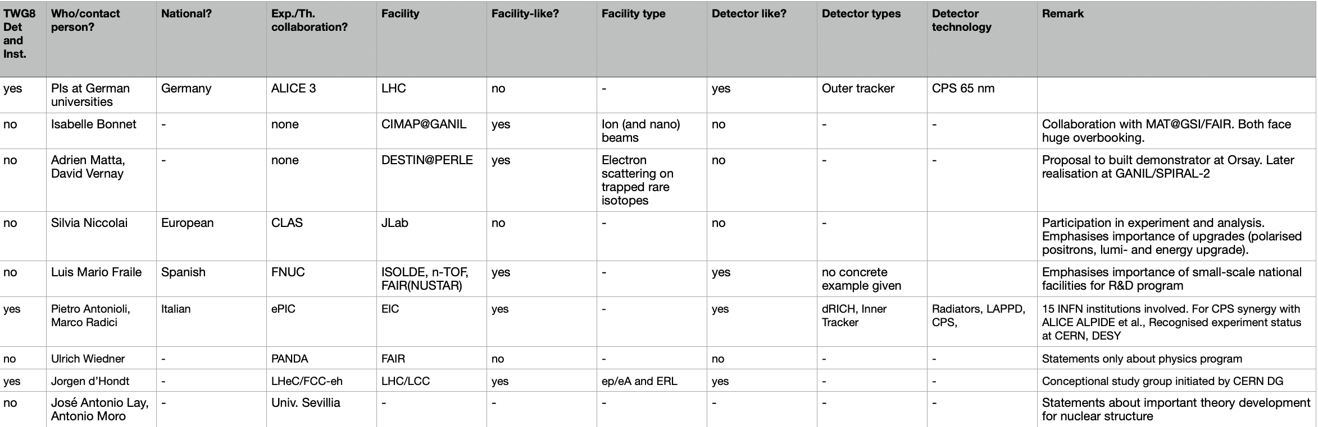
Detailed analysis Part V
3/9

Slide 42
Final numbers
32/133 related to HE NP
  Not all related to Hardware and R&D
  Sharing between chapters 4/5 may be needed as a next step
  Focus on future developments

