Slide 1
Eta-Earth revisited II Deriving a Maximum Number of Earth-Like Habitats in the Galactic Disk
Daniel Karner
ORIGINS PhD Journal Club (8 April 2025)

Slide 2
How does this paper fit into the Journal club?
High-Impact Papers
Review papers
Interesting papers (according to the speaker)
Bad papers
Funny papers
Unpublished manuscripts (to receive feedback from peers)
Interdisciplinary paper! (astrophysics, geology, biology, chemistry, philosophy)

Slide 3
Central claim:
“Our estimate will for the first time give a quantifiable upper limit on earth-like habitats existing in the Milky Way.”

Slide 4
How did I even find out about this paper?
Appeared on arXiv after publication
Appeared in (Austrian) news (lots of advertisement!)

Slide 5
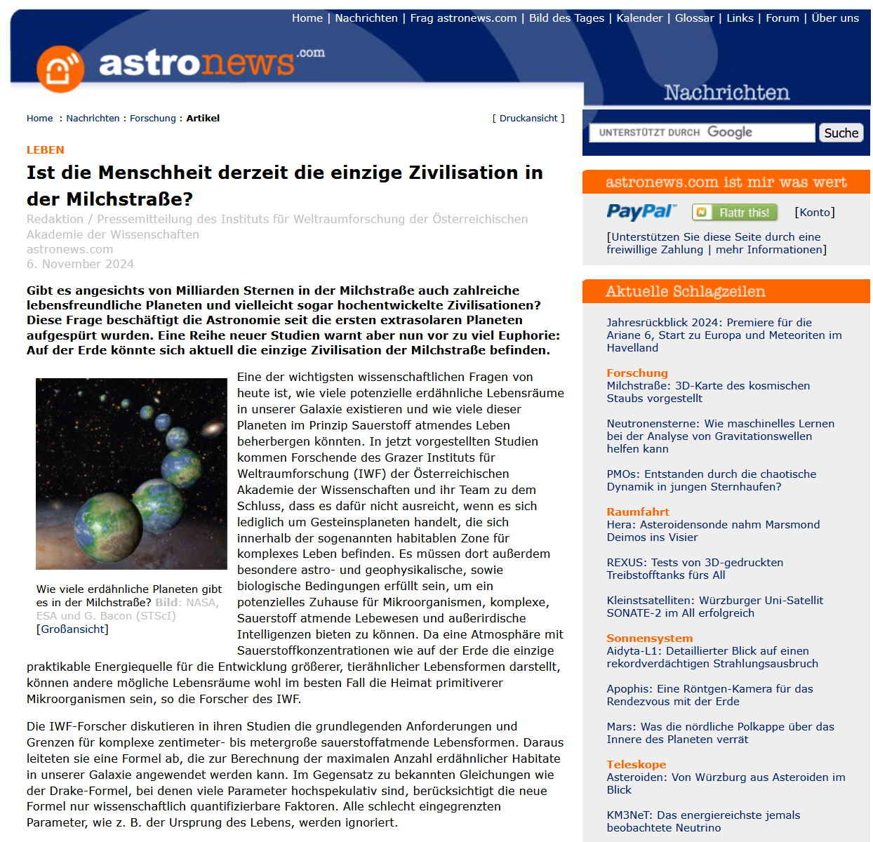
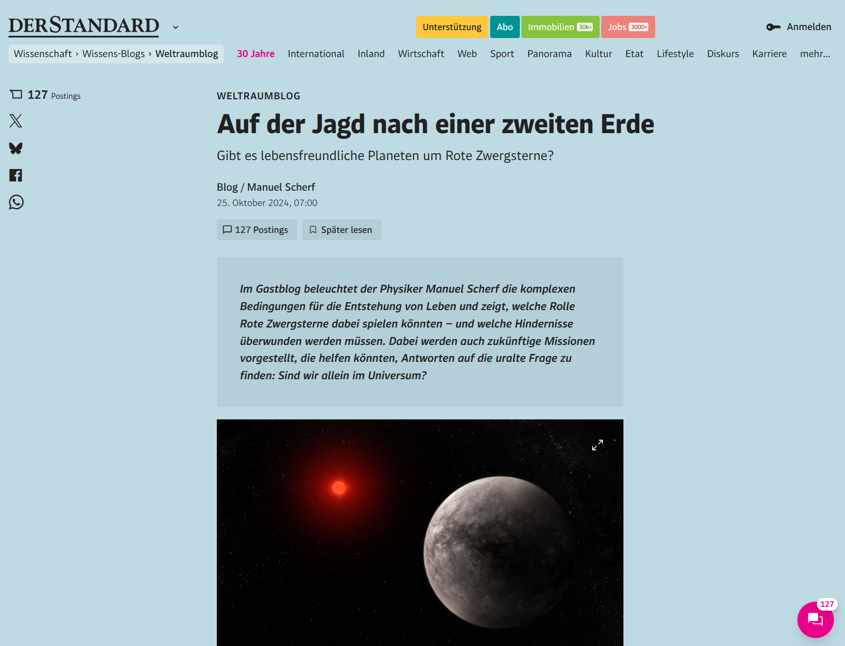
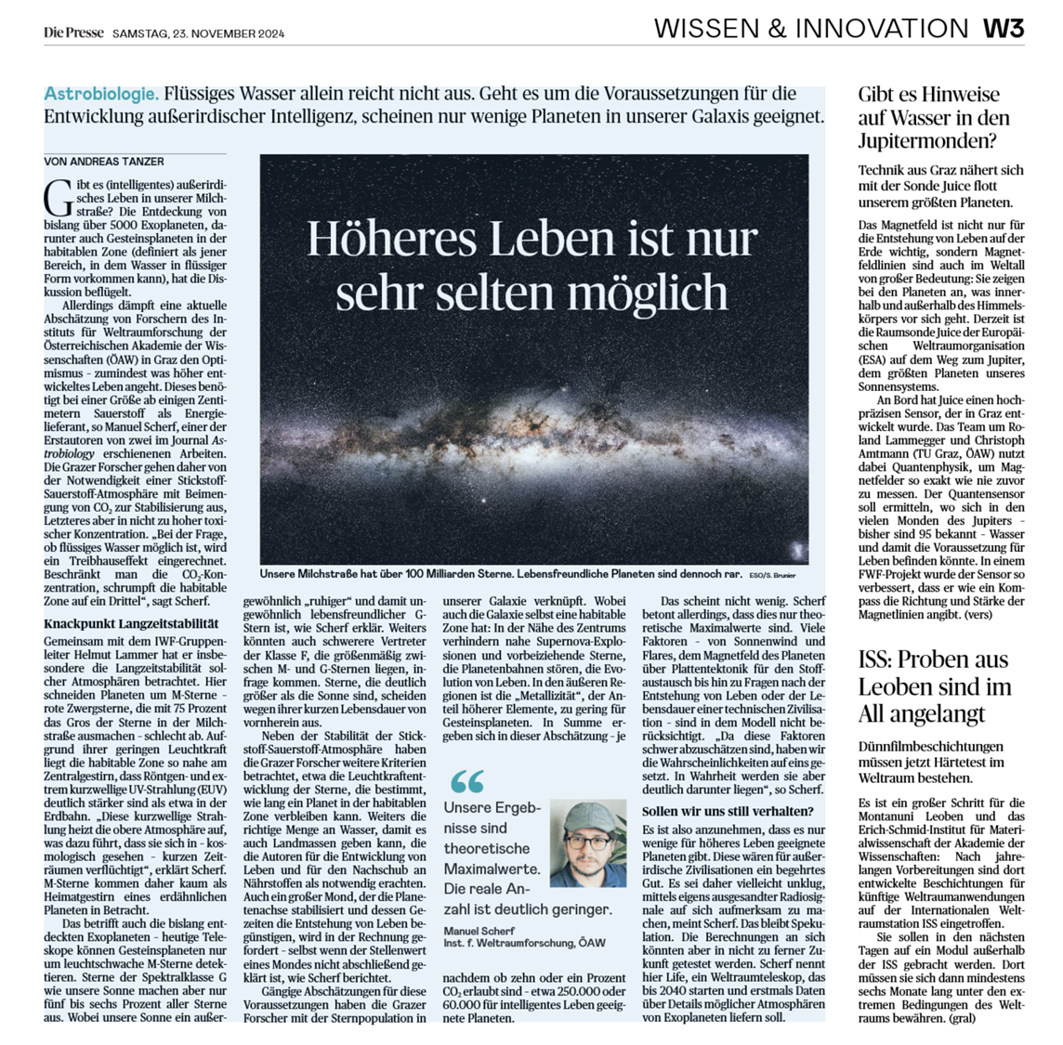
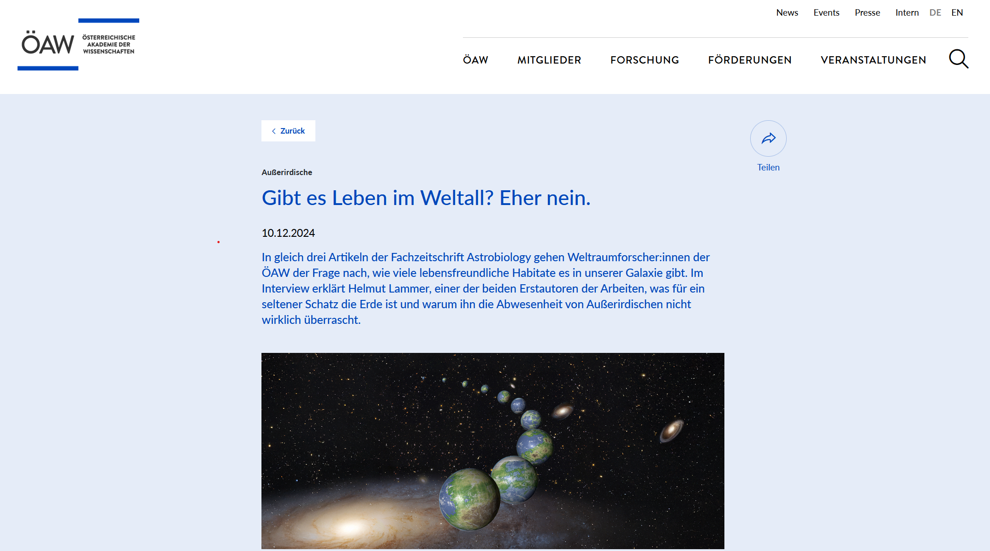

Slide 6
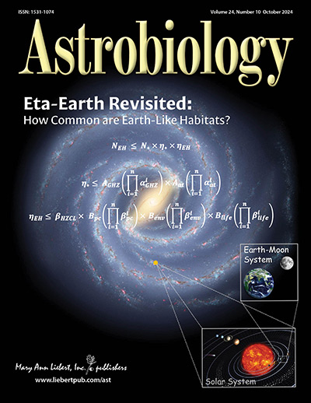

Slide 7
3 papers
Commentary:
Preface to Eta-Earth Revisited: How Common Are Earth-like Habitats in the Galaxy?
(Helmut Lammer & Manuel Scherf)
Hypothesis Article:
Eta-Earth Revisited I: A Formula for Estimating the Maximum Number of Earth-Like Habitats
(Helmut Lammer, Manuel Scherf & Laurenz Sproß)
Research Article:
Eta-Earth Revisited II: Deriving a Maximum Number of Earth-Like Habitats in the Galactic Disk
(Manuel Scherf, Helmut Lammer & Laurenz Sproß)

Slide 8
Some introductory comments

Slide 9
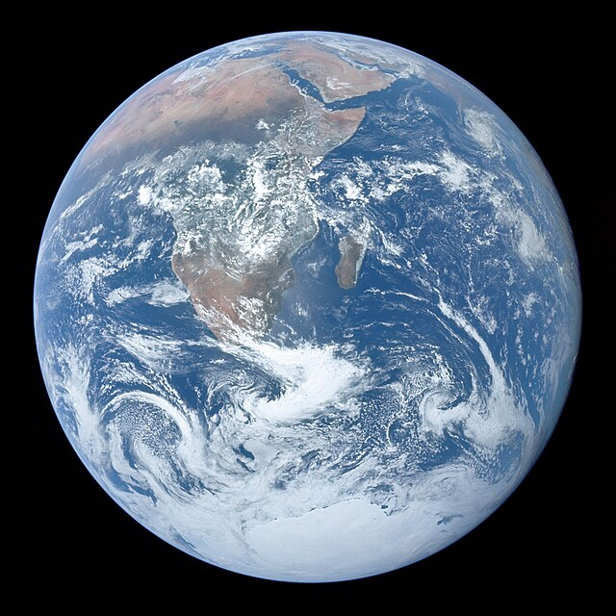
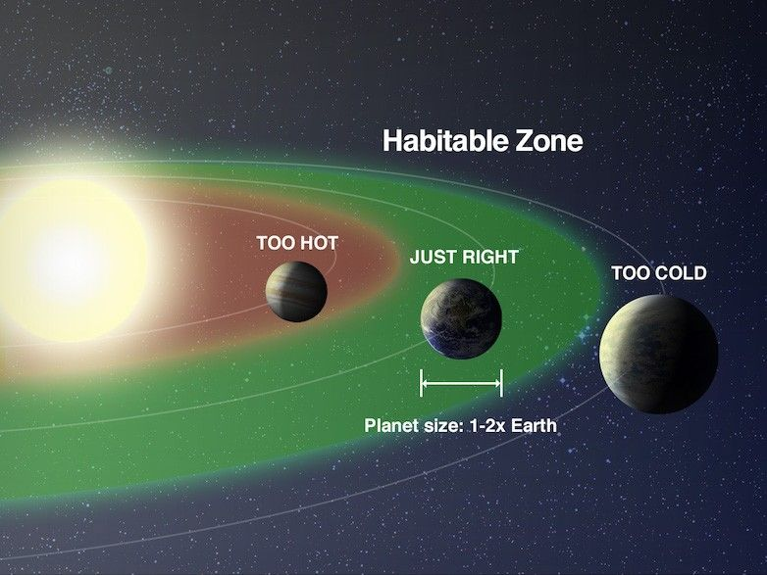
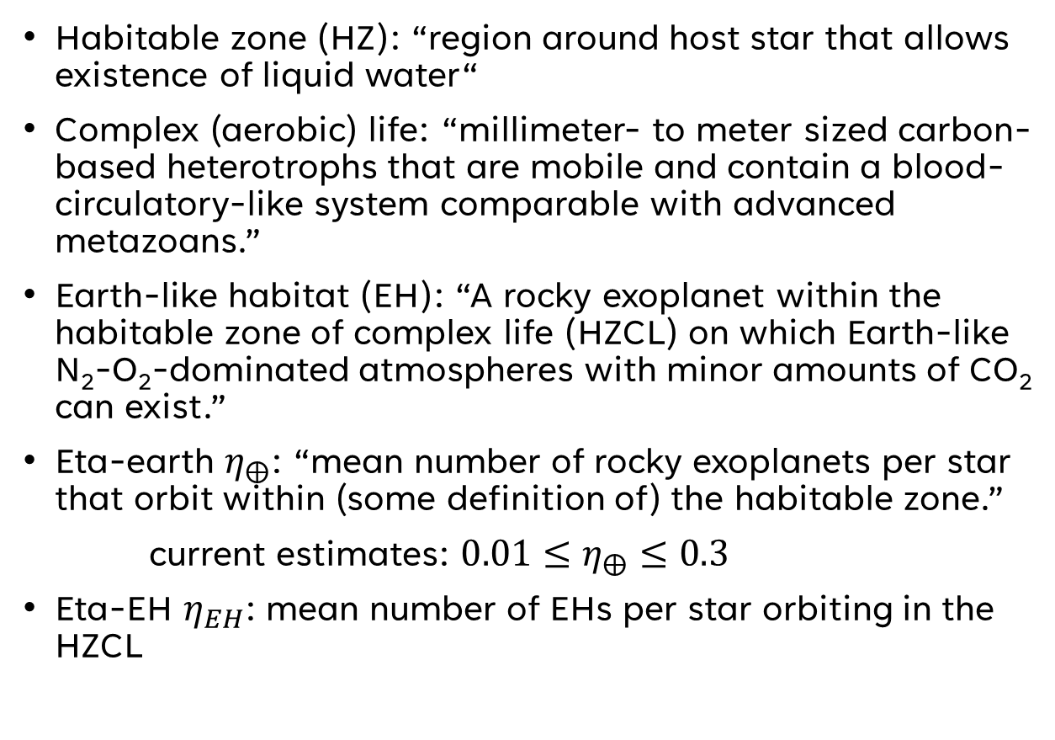
Some definitions
Habitable zone (HZ): “region around host star that allows existence of liquid water“
Complex (aerobic) life: “millimeter- to meter sized carbon-based heterotrophs that are mobile and contain a blood-circulatory-like system comparable with advanced metazoans.”
Earth-like habitat (EH): “A rocky exoplanet within the habitable zone of complex life (HZCL) on which Earth-like N₂-O₂-dominated atmospheres with minor amounts of CO₂ can exist.”
Eta-earth $η_{⨁}$: “mean number of rocky exoplanets per star that orbit within (some definition of) the habitable zone.”
current estimates: ${0.01≤η}_{⨁}≤0.3$
Eta-EH $η_{EH}$: mean number of EHs per star orbiting in the HZCL
Notes:
Assumption: On an earth-like habitat advanced animal-like life or potentially even extraterrestrial intelligent life can in principle evolve and exist.
Heterotroph organisms have to eat other life forms in order to survive.
Large range for literature values of eta-earth largely comes from poor definition.
Earth-like habitat (EH): “rocky exoplanets in the habitable zone for complex life that host N₂-O₂-dominated atmospheres with minor amounts of CO₂, at which advanced animal-like life or potentially even extraterrestrial intelligent life can in principle evolve and exist.”
HZCL mainly takes CO2 limits into account (stricter limit for maximum CO2 concentration -> smaller HZCL -> see percentage values on figure on next slide)

Slide 10
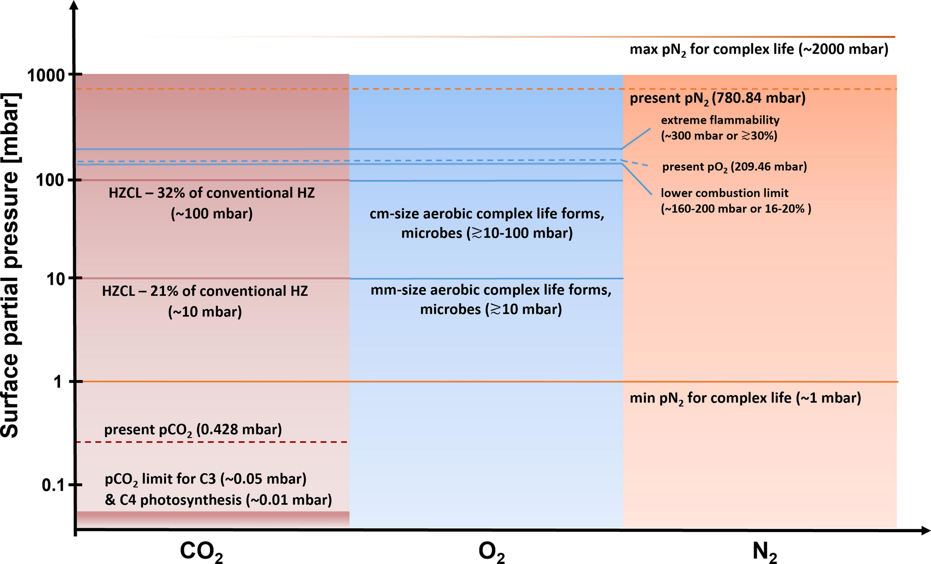
Atmospheric composition (paper 1)
Notes:
Question: Why is oxygen a key ingredient for complex life? Answer: The reduction of O2 provides the largest free energy release per electron transfer, except for fluorine (F) and chlorine (Cl). However, fluorine and chlorine are so reactive that they cannot build up a significant concentration in a planetary atmosphere, which oxygen can indeed do.
Note: Oxygen becomes toxic for humans above 0.5 bar and irreversible damage occurs above 1 bar.

Slide 11
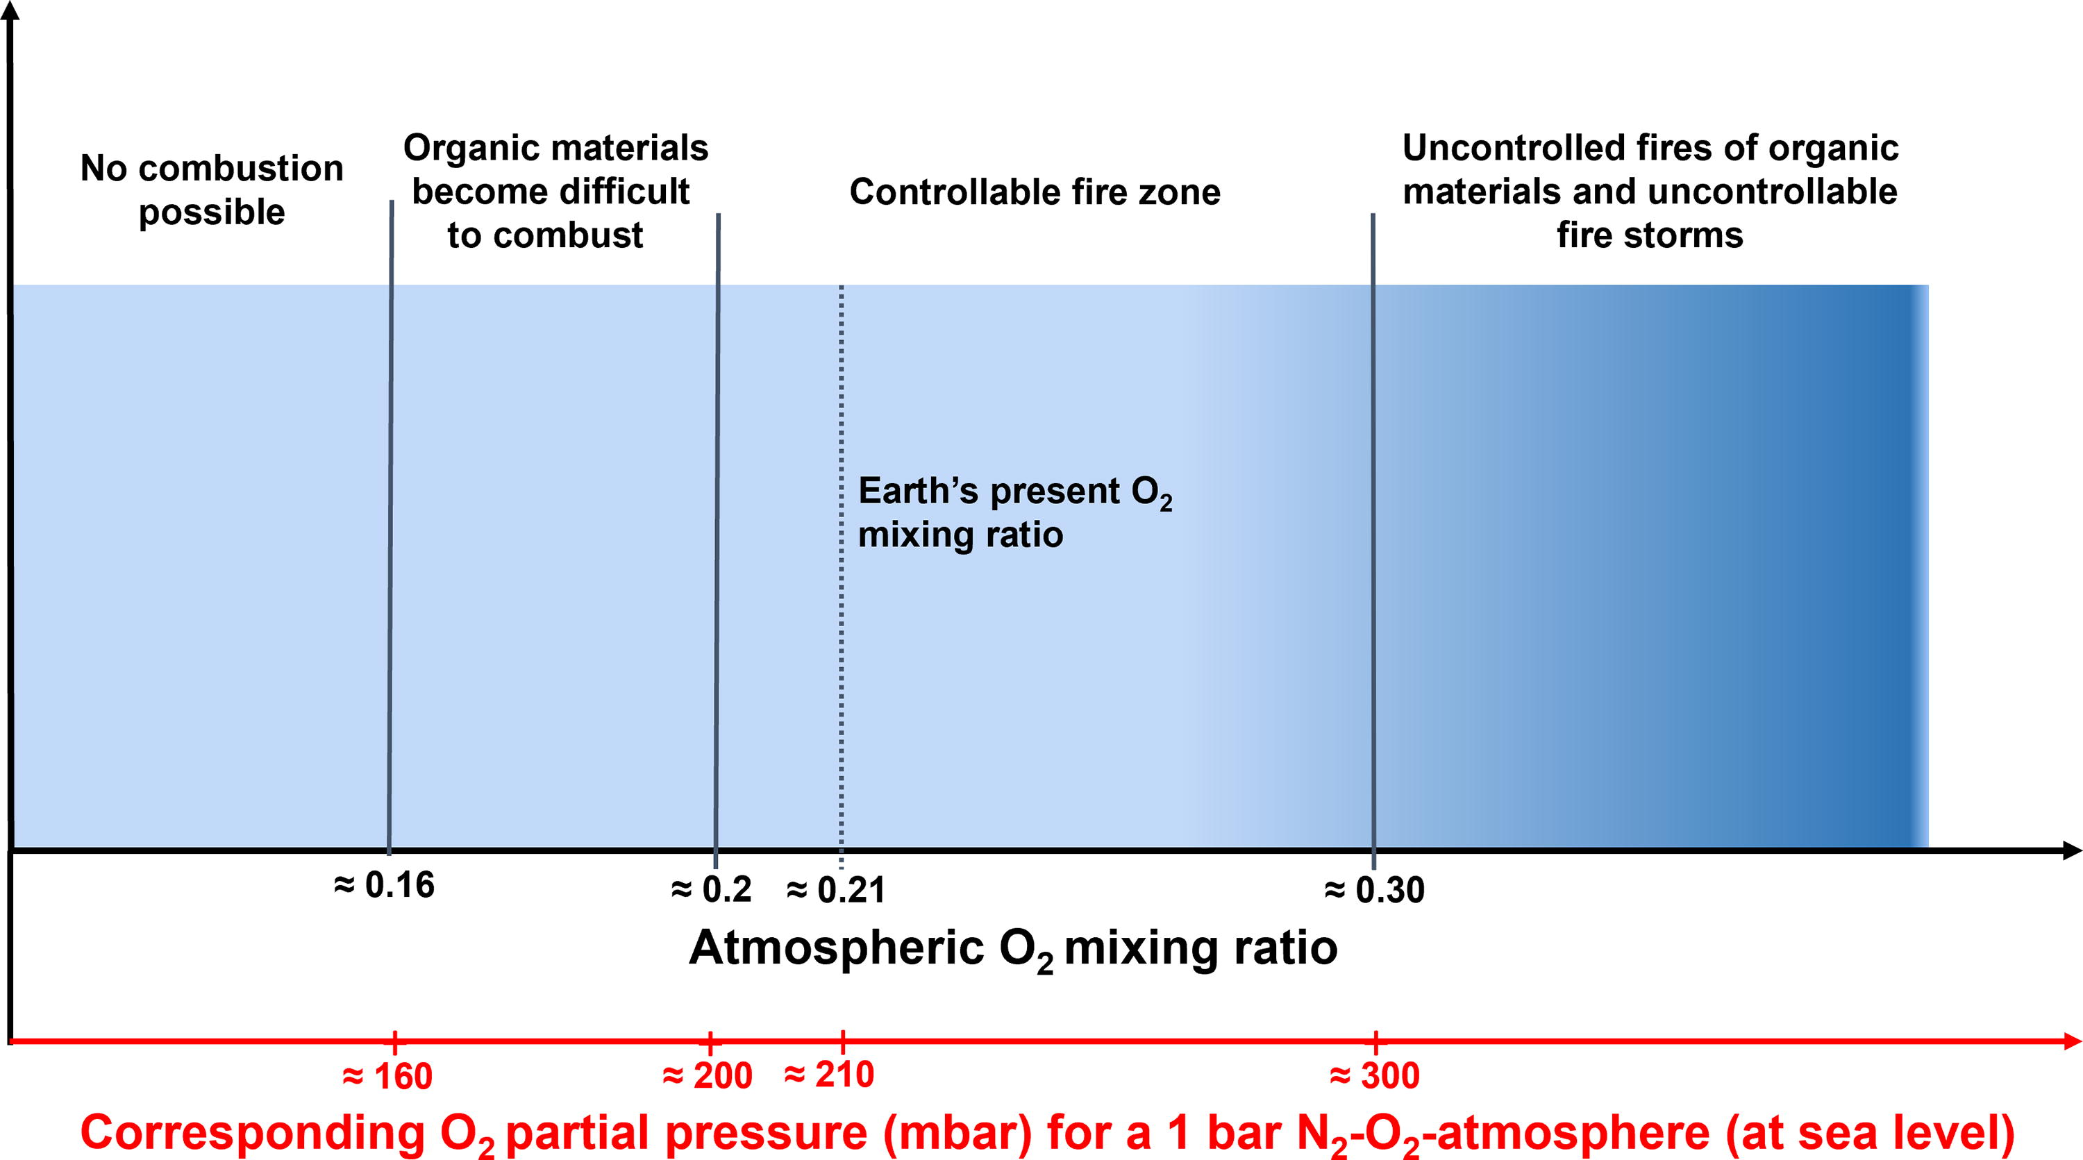
Atmospheric composition (paper 1)

Slide 12
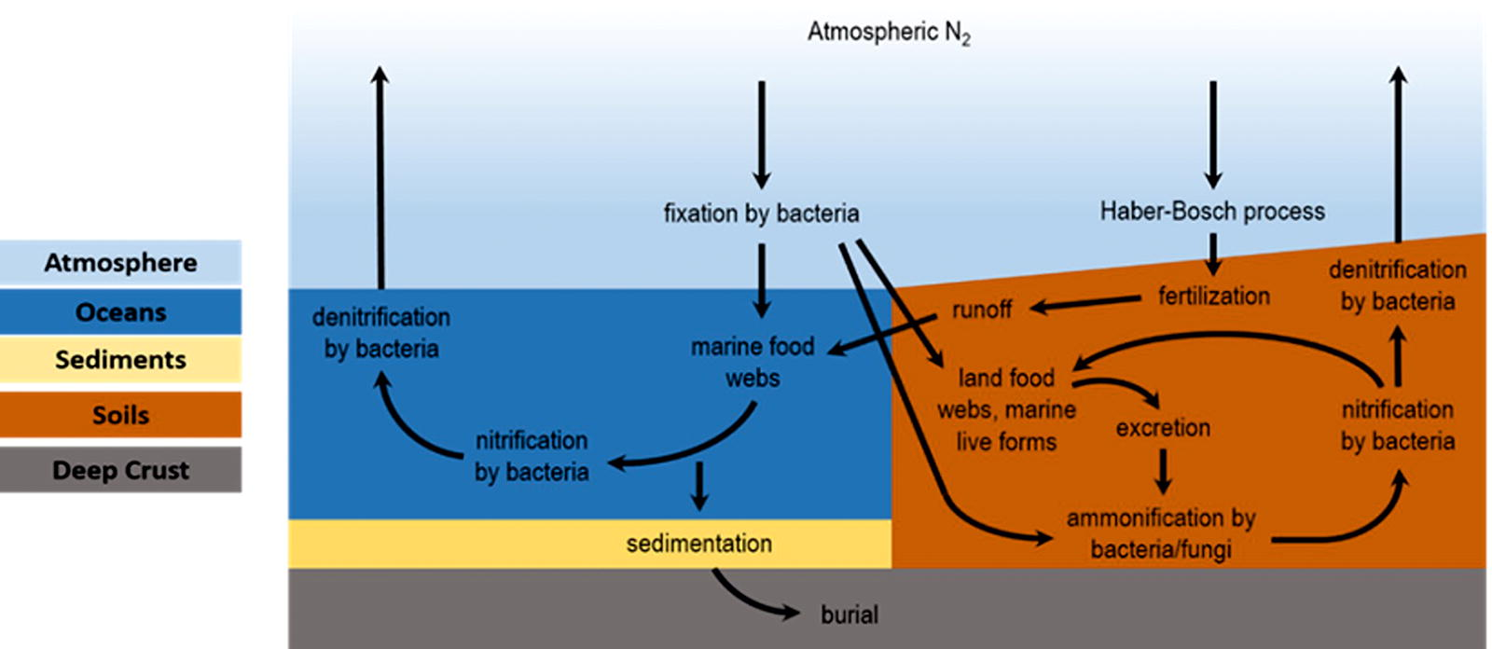
Atmospheric composition (paper 1)

Slide 13
Let‘s dive into the paper

Slide 14
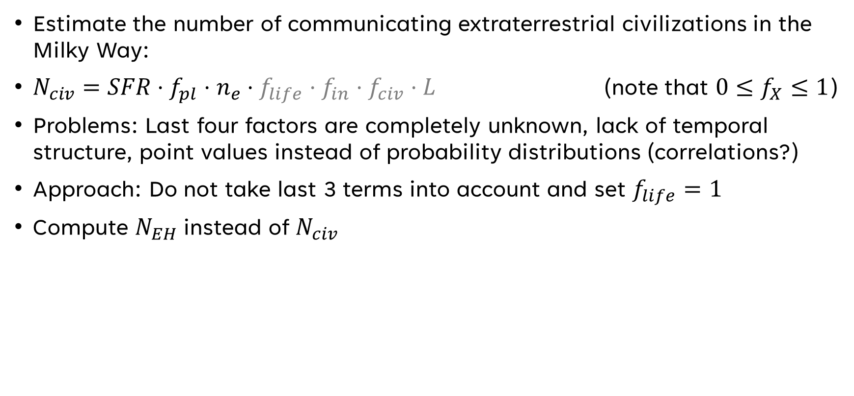
The Drake equation (1961)
Estimate the number of communicating extraterrestrial civilizations in the Milky Way:
$N_{civ}=SFR⋅f_{pl}⋅n_{e}⋅f_{life}⋅f_{in}⋅f_{civ}⋅L$ (note that ${0≤f}_{X}≤1$)
Problems: Last four factors are completely unknown, lack of temporal structure, point values instead of probability distributions (correlations?)
Approach: Do not take last 3 terms into account and set $f_{life}=1$
Compute $N_{EH}$ instead of $N_{civ}$
Notes:
Parameters in Drake equation: Nciv… number of hypothetical extraterrestrial civilizations in the Galaxy that communicate through electromagnetic waves, SFR… average rate of star formation in the Galaxy, fpl… fraction of stars with planets, ne… number of habitable planets per planet-hosting star, flife… fraction of those planets that host life, fin… fraction of such planets with intelligent life, and fciv is the fraction of intelligent life that releases detectable signs of their existence into space (i.e., civilizations). Finally, L is the timespan over which such civilizations release these signals into space.
Lack of temporal structure: fixed star formation rate instead of considering star formation history of Milky Way

Slide 15

Key equation
$$N_{EH}{≤N}_{⋆}⋅η_{⋆}⋅η_{EH}$$
$N_{⋆}$…number of stars in Milky Way
$η_{⋆}$…fraction of stars able to host an EH
$η_{EH}$…occurrence rate of EHs in the HZCL

Slide 16

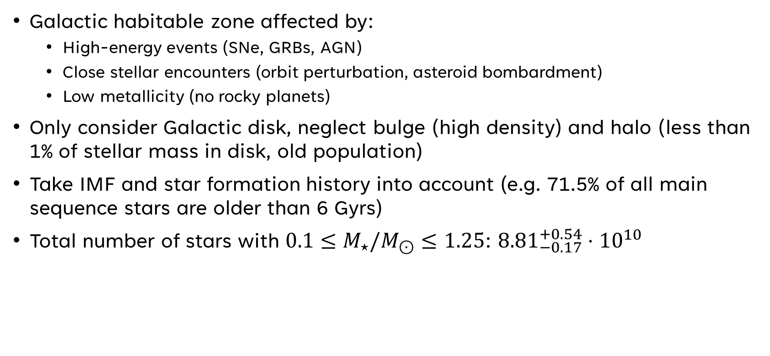
Number of stars $N_{⋆}$
Galactic habitable zone affected by:
High-energy events (SNe, GRBs, AGN)
Close stellar encounters (orbit perturbation, asteroid bombardment)
Low metallicity (no rocky planets)
Only consider Galactic disk, neglect bulge (high density) and halo (less than 1% of stellar mass in disk, old population)
Take IMF and star formation history into account (e.g. 71.5% of all main sequence stars are older than 6 Gyrs)
Total number of stars with $0.1≤M_{⋆}/M_{⊙}≤1.25$: ${8.81}_{−0.17}^{+0.54}⋅{10}^{10}$
Notes:
The old population in the halo is problematic due to (1) limited radiogenic heat budget of exoplanets (e.g. Earth can maintain geological activity for ~6Gyr) and (2) limited main sequence lifetime of even G-stars (M dwarfs are not very attractive for other reasons)
The bulge population is problematic due to (1) more supernovae, (2) AGN activity of Sagittarius A* in the past, (3) tidal disruption events close to Sgr A*, (4) more close (~1000 AU) stellar encounters

Slide 17

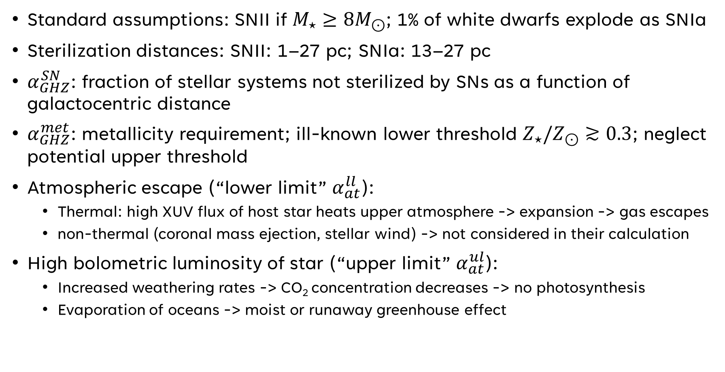
Fraction of stars, $η_{⋆}$, able to host EHs
Standard assumptions: SNII if $M_{⋆}≥8M_{⊙}$; 1% of white dwarfs explode as SNIa
Sterilization distances: SNII: 1–27 pc; SNIa: 13–27 pc
$α_{GHZ}^{SN}$: fraction of stellar systems not sterilized by SNs as a function of galactocentric distance
$α_{GHZ}^{met}$: metallicity requirement; ill-known lower threshold $Z_{⋆}/Z_{⊙}≳0.3$; neglect potential upper threshold
Atmospheric escape (“lower limit” $α_{at}^{ll}$):
Thermal: high XUV flux of host star heats upper atmosphere -> expansion -> gas escapes
non-thermal (coronal mass ejection, stellar wind) -> not considered in their calculation
High bolometric luminosity of star (“upper limit” $α_{at}^{ul}$):
Increased weathering rates -> CO₂ concentration decreases -> no photosynthesis
Evaporation of oceans -> moist or runaway greenhouse effect
Notes:
Note: it was suggested that the sun might have been born at 5 kpc and then migrated to its current distance of 8.1 kpc (higher metallizity at beginning, but lower SN rate during migration)
Young, low mass stars: XUV flux is too high; older, higher mass stars: bolometric luminosity is too high.
Comment: gradual increase of orbit due to stellar mass loss is negligible for low-mass stars during the main-sequence phase. However, the steady increase of bolometric luminosity can make habitability impossible (runaway greenhouse effect)

Slide 18
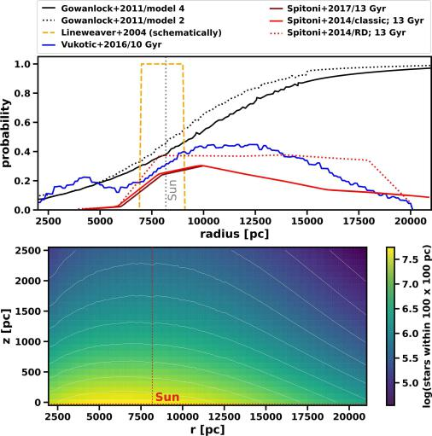
Galactic habitable zone (simplified)
not sterilized by SNe
Notes:
The old population in the halo is problematic due to (1) limited radiogenic heat budget of exoplanets (e.g. Earth can maintain geological activity for ~6Gyr) and (2) limited main sequence lifetime of even G-stars (M dwarfs are not very attractive for other reasons)
The bulge population is problematic due to (1) more supernovae, (2) AGN activity of Sagittarius A* in the past, (3) tidal disruption events close to Sgr A*, (4) more close (~1000 AU) stellar encounters

Slide 19
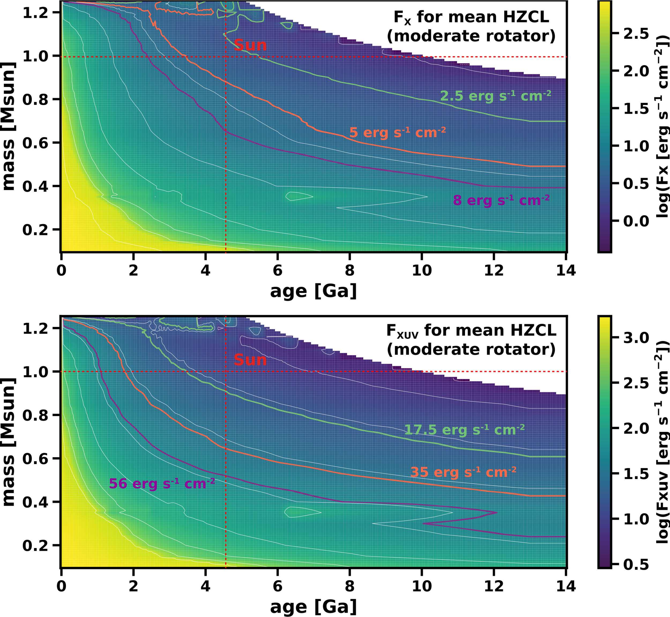
Stellar X-ray and XUV flux (threshold is orange)

Slide 20
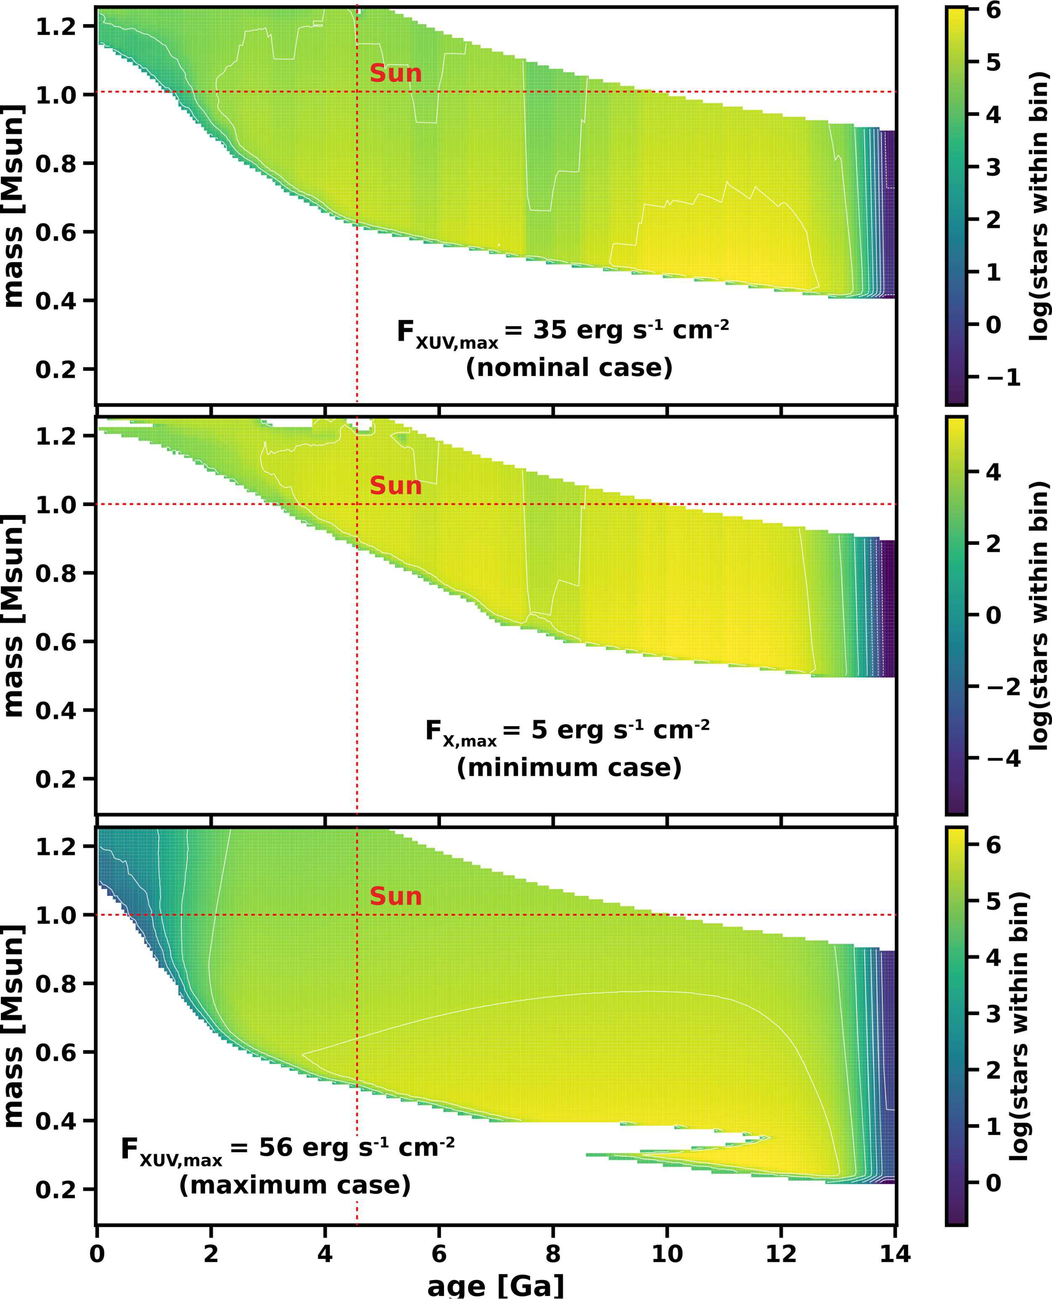
Lower limit from XUV flux

Slide 21
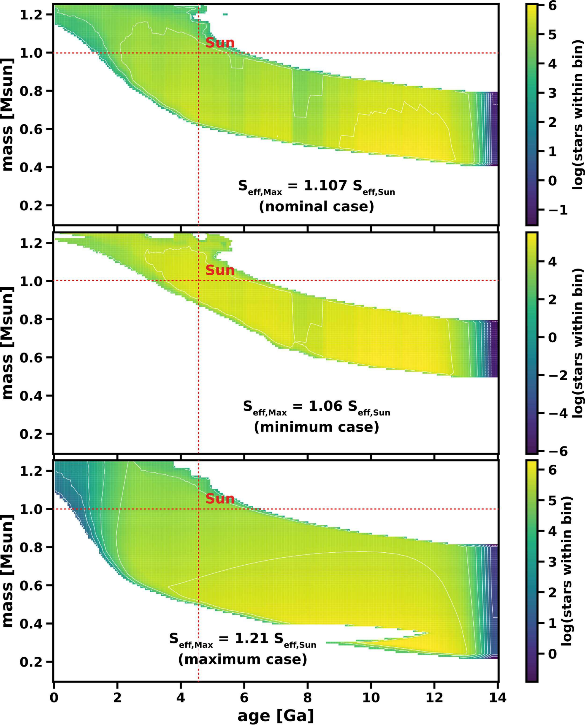
Upper limit from bolometric luminosity

Slide 22
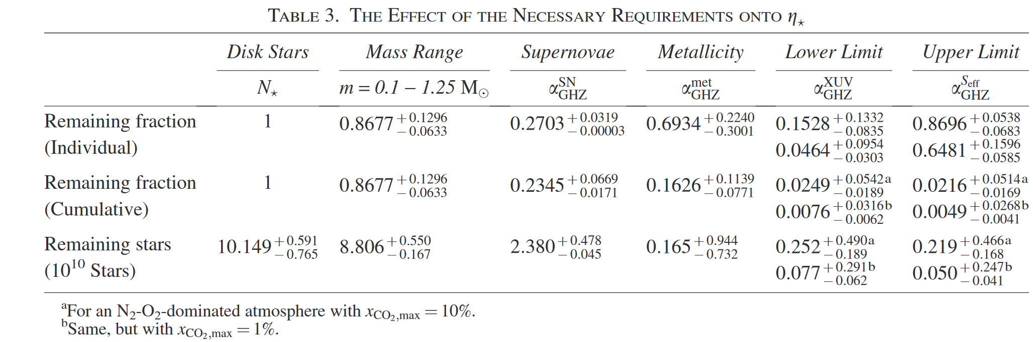

Summary of $η_{⋆}$
XUV flux is most severe limitation
Notes:
Note: it was suggested that the sun might have been born at 5 kpc and then migrated to its current distance of 8.1 kpc (higher metallizity at beginning, but lower SN rate during migration)
Young, low mass stars: XUV flux is too high; older, higher mass stars: bolometric luminosity is too high.

Slide 23
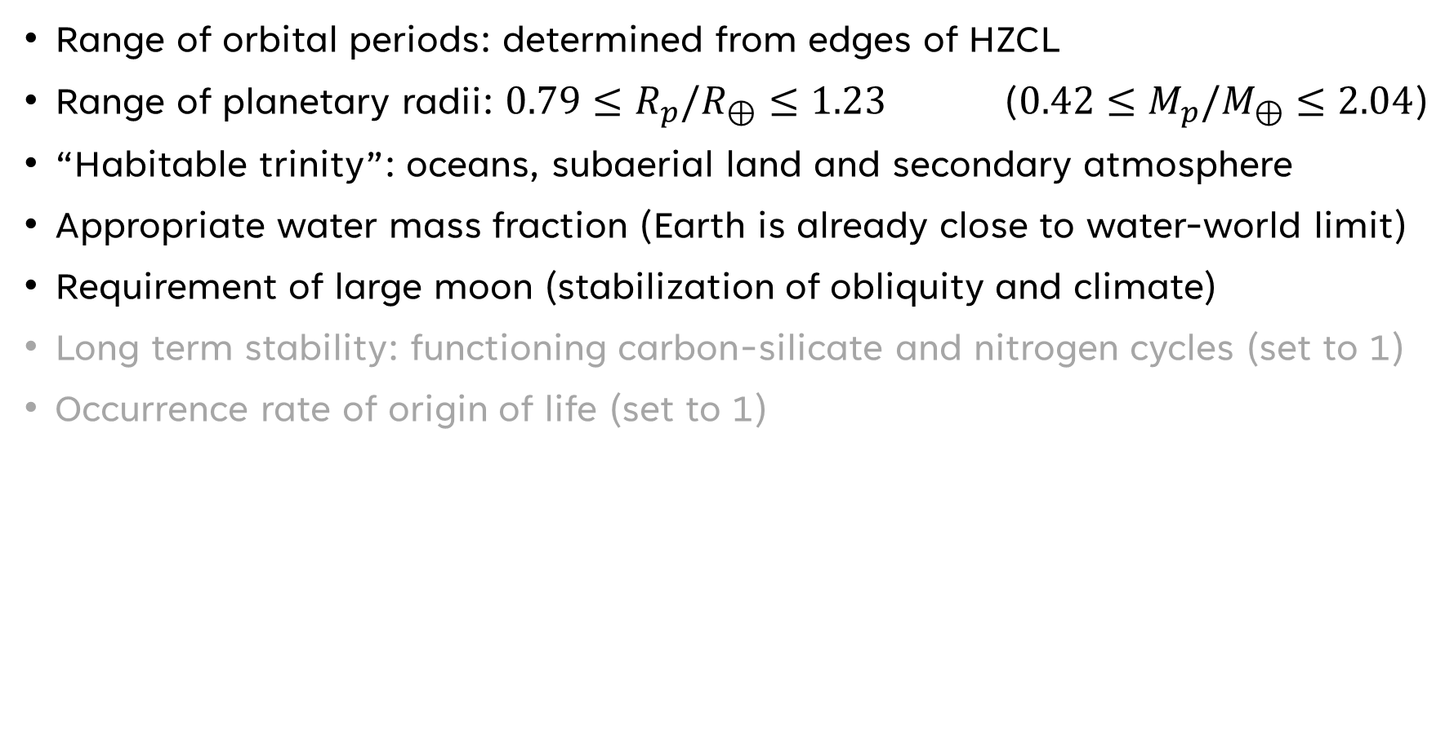
Occurrence rate of EHs within the HZCL $η_{EH}$
Range of orbital periods: determined from edges of HZCL
Range of planetary radii: $0.79≤R_{p}/R_{⊕}≤1.23$ ($0.42≤M_{p}/M_{⊕}≤2.04$)
“Habitable trinity”: oceans, subaerial land and secondary atmosphere
Appropriate water mass fraction (Earth is already close to water-world limit)
Requirement of large moon (stabilization of obliquity and climate)
Long term stability: functioning carbon-silicate and nitrogen cycles (set to 1)
Occurrence rate of origin of life (set to 1)
Notes:
Planet with low masses cannot hold onto their secondary atmosphere; planets with high masses start turning into Neptun-like objects
Also planets with Rp>1.3 RE may have thick primordial atmosphere with underlying supercritical layer of water and these planets may not be able to form large moons (material quickly falls back on host planet)
Neither water worlds (no nutrients cycle) nor dessecated planets (no solvent) seem to be good condidates for habitats. Water can be added to a planet by (1) planetesimal and pebble accretion, (2) direct chemical reaction between hydrogen in accreted stellar nebula gas and the underlying magma ocean. Water can be removed by (1) early hydrodynamic escape (M-dwarfs!), (2) partitioning of water between mantle and surface
Large moons might not be stable in dwarf-star systems; moon supports transport of nutrients (tides), tectonic activity, delivery of water

Slide 24
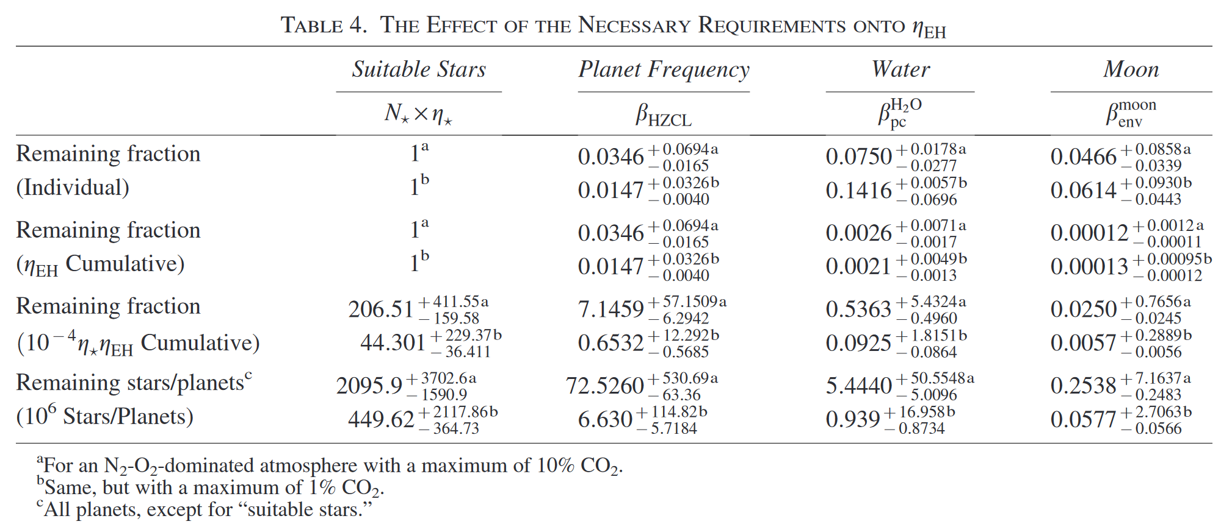


Summary of $η_{EH}$
Similar to $η_{⊕}$, but scaled to HZCL

Slide 25
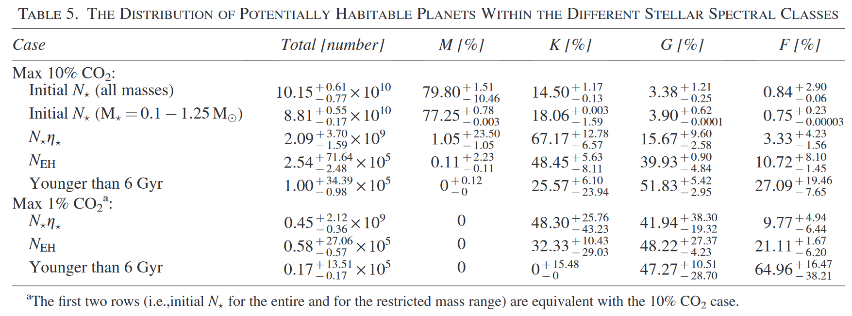
Distribution of EHs within different stellar spectral classes

Slide 26

Final result
$$N_{EH,10\%}≤{2.54}_{−2.48}^{+71.64}⋅{10}^{5}$$
$$N_{EH,1\%}≤{0.58}_{−0.57}^{+27.06}⋅{10}^{5}$$

Slide 27
Caveats
Point values instead of probability distributions
“Many factors concerning the emergence and evolution of EHs cannot be scientifically quantified at present.”
Did they overlook important factors in their study? No real problem, since goal was to find a maximum number of EHs
Unlikely that their numbers underestimate EHs within the Galactic disk
They only consider rocky exoplanets and neglect Hycean worlds, subsurface ocean worlds, brown dwarf habitats, life on exomoons
Restriction on present-day Milky Way (no other galaxies)
What about long-term stability of a planetary system?
Notes:
The argument for only considering rocky exoplanets is that „we can evaluate their existence at least partially based on some hard physical parameters.”
A hycean planet (hydrogen+ocean) is a hypothetical type of exoplanet that features a liquid water ocean underneath a hydrogen-rich atmosphere.
Note that exomoons with Earth’s mass may be quite rare or only possible around a brown dwarf (due to a correlation between planet mass and moon mass).
Habitability around a white dwarf or neutron star is quite challenging (high XUV flux, decreasing HZ)
Concerning the last point: they do include a discussion on perturbations by close stellar encounters, but do not address the questions how many planets in a HZCL remain there for several Gyr (long-term stability of multi-planet system against growing perturbations)

Slide 28
My takeaways
Paper II provides an excellent review of factors affecting habitability (~1090 references, including A. Loeb)
Habitable planets are rare, and Earth is precious
Philosophical implication: Copernican Principle of Mediocrity is not applicable
M-dwarfs are abundant, but unattractive for EHs (XUV flux, strong flares, tidally locked) -> “red sky paradox” (see sec. 7.4 for a list of arguments)
Glossary at the end is nice; a collection of definitions would have also been helpful (they are spread over the text)
It was not clear if their parameters are fractions or can be larger than 1
Notes:
Even a reference to the film Interstellar is provided ;-)
Logical fallacy: Copernican principle says that Earth is not special and therefore complex life should be common in the Universe. Correct way to think about it: If planetary parameters are very similar to each other, then it is not important whether we live on this or on any other planet that fulfills certain parameters. In this tautological sense, the Copernican Principle logically holds.

